Slide 1
Hamiltonian Monte Carlo on Manifolds
Chang Liu
2015-09-14

Slide 2
Outline
Introduction to Hamiltonian Monte Carlo
Riemann manifold Langevin and Hamiltonian Monte Carlo methods (Girolami & Calderhead, 2011)
Geodesic Monte Carlo on Embedded Manifolds (Byrne & Girolami, 2013)

Slide 3
Introduction to Hamiltonian Monte Carlo (Ref: Neal, 2011)
History
Overview
Hamiltonian Dynamics
MCMC from Hamiltonian dynamics
Illustrations of HMC and its benefits

Slide 4
History
Background: for the task of simulating the distribution of states for a system of idealized molecules,
(Metropolis, et al., 1953): MCMC with Metropolis test.
(Alder & Wainwright, 1959): deterministic approach by simulating Hamiltonian dynamics.
Birth: combining (hybrid)
(Duane, et al., 1987): Hybrid Monte Carlo. Renamed as Hamiltonian Monte Carlo afterwards.
Application to statistics
(Neal, 1993ab): probabilistic inference and Bayesian learning
(Neal, 1996a): neural network models
(Ishwaran, 1999): generalized linear models
…

Slide 5
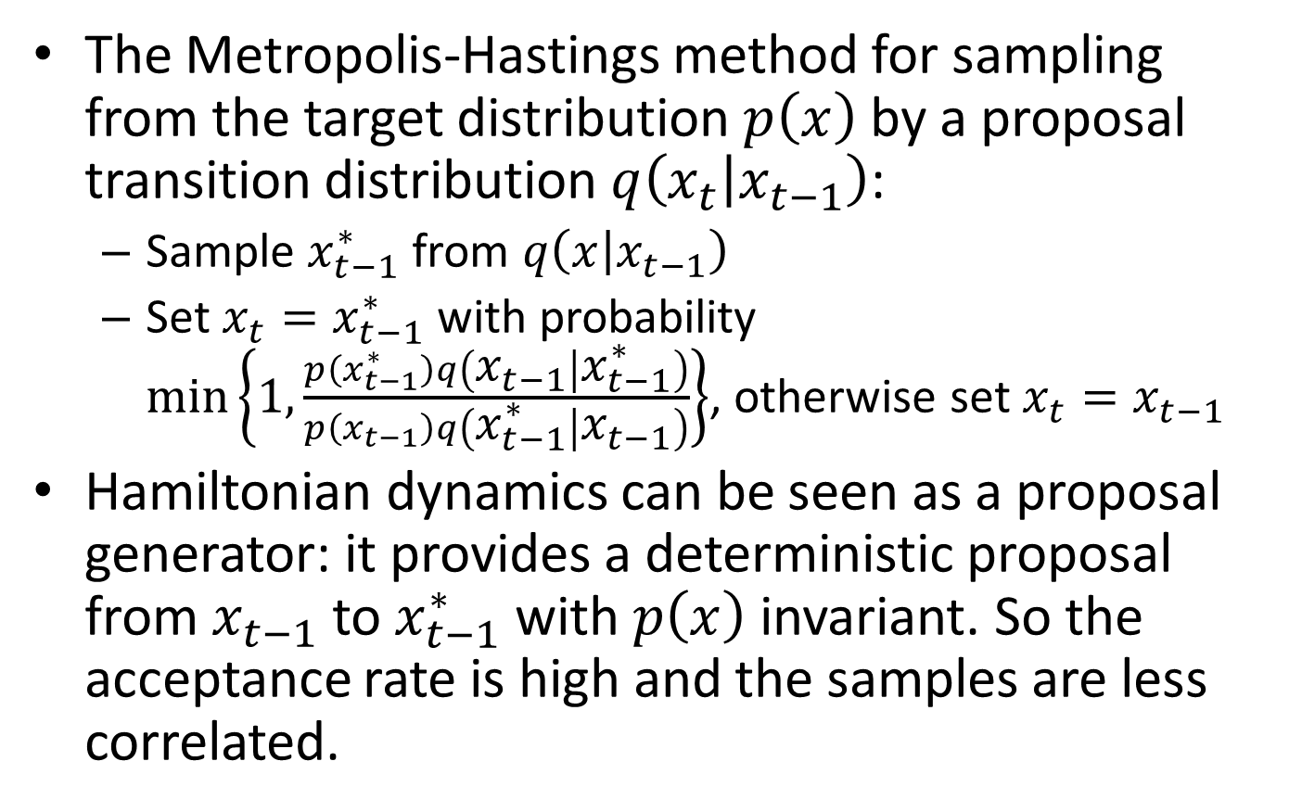
Overview
The Metropolis-Hastings method for sampling from the target distribution $p\left(x\right)$ by a proposal transition distribution $q\left(x_{t} | x_{t−1}\right)$:
Sample $x_{t−1}^{∗}$ from $q\left(x | x_{t−1}\right)$
Set $x_{t}=x_{t−1}^{∗}$ with probability $\min\left\{1,\frac{p\left(x_{t−1}^{∗}\right)q\left(x_{t−1} | x_{t−1}^{∗}\right)}{p\left(x_{t−1}\right)q\left(x_{t−1}^{∗} | x_{t−1}\right)}\right\}$, otherwise set $x_{t}=x_{t−1}$
Hamiltonian dynamics can be seen as a proposal generator: it provides a deterministic proposal from $x_{t−1}$ to $x_{t−1}^{∗}$ with $p\left(x\right)$ invariant. So the acceptance rate is high and the samples are less correlated.

Slide 6
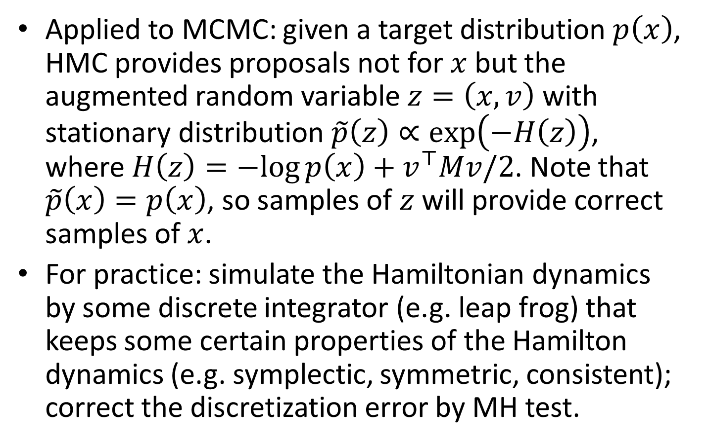
Overview
Applied to MCMC: given a target distribution $p\left(x\right)$, HMC provides proposals not for $x$ but the augmented random variable $z=\left(x,v\right)$ with stationary distribution $\tilde{p}\left(z\right)∝\exp\left(−H\left(z\right)\right)$, where $H\left(z\right)=−log{p\left(x\right)}+v^{⊤}Mv/2$. Note that $\tilde{p}\left(x\right)=p\left(x\right)$, so samples of $z$ will provide correct samples of $x$.
For practice: simulate the Hamiltonian dynamics by some discrete integrator (e.g. leap frog) that keeps some certain properties of the Hamilton dynamics (e.g. symplectic, symmetric, consistent); correct the discretization error by MH test.

Slide 7
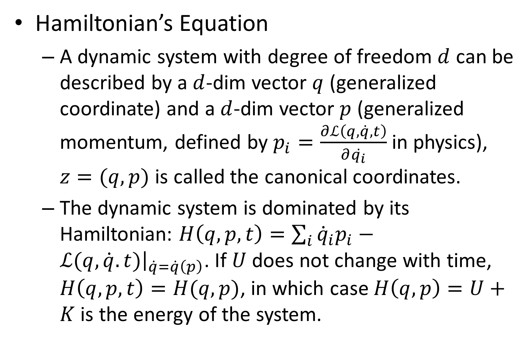
Hamiltonian Dynamics
Hamiltonian’s Equation
A dynamic system with degree of freedom $d$ can be described by a $d$-dim vector $q$ (generalized coordinate) and a $d$-dim vector $p$ (generalized momentum, defined by $p_{i}=\frac{∂ℒ\left(q,\dot{q},t\right)}{∂\dot{q_{i}}}$ in physics), $z=(q,p)$ is called the canonical coordinates.
The dynamic system is dominated by its Hamiltonian: $H\left(q,p,t\right)=\sum_{i}{{\dot{q}}_{i}p_{i}}−ℒ(q,\dot{q}.t){\left.​\right|}_{\dot{q}=\dot{q}\left(p\right)}$. If $U$ does not change with time, $H\left(q,p,t\right)=H(q,p)$, in which case $H\left(q,p\right)=U+K$ is the energy of the system.

Slide 8
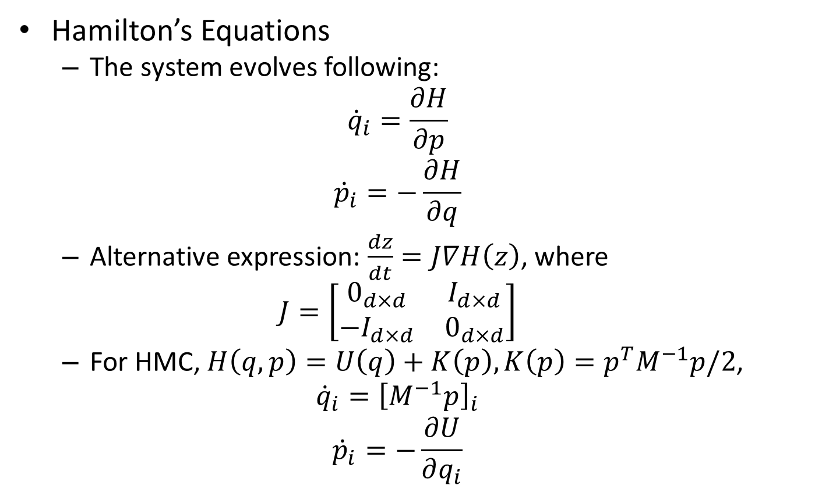
Hamiltonian Dynamics
Hamilton’s Equations
The system evolves following:
$${\dot{q}}_{i}=\frac{∂H}{∂p}$$
$${\dot{p}}_{i}=−\frac{∂H}{∂q}$$
Alternative expression: $\frac{dz}{dt}=J∇H\left(z\right)$, where
$$J=\left[\begin{matrix}0_{d×d} & I_{d×d} \\ −I_{d×d} & 0_{d×d}\end{matrix}\right]$$
For HMC, $H\left(q,p\right)=U\left(q\right)+K\left(p\right),K\left(p\right)=p^{T}M^{−1}p/2$,
$${\dot{q}}_{i}={\left[M^{−1}p\right]}_{i}$$
$${\dot{p}}_{i}=−\frac{∂U}{∂q_{i}}$$

Slide 9

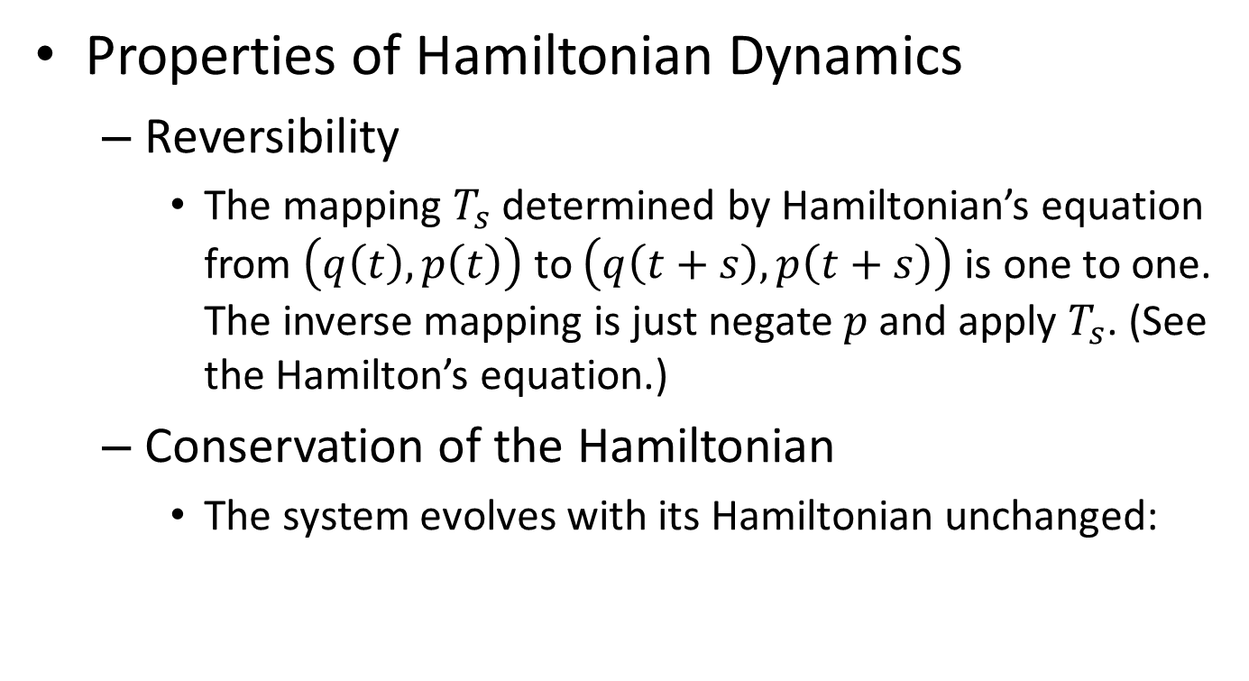
Hamiltonian Dynamics
Properties of Hamiltonian Dynamics
Reversibility
The mapping $T_{s}$ determined by Hamiltonian’s equation from $\left(q\left(t\right),p\left(t\right)\right)$ to $\left(q\left(t+s\right),p\left(t+s\right)\right)$ is one to one. The inverse mapping is just negate $p$ and apply $T_{s}$. (See the Hamilton’s equation.)
Conservation of the Hamiltonian
The system evolves with its Hamiltonian unchanged:

Slide 10
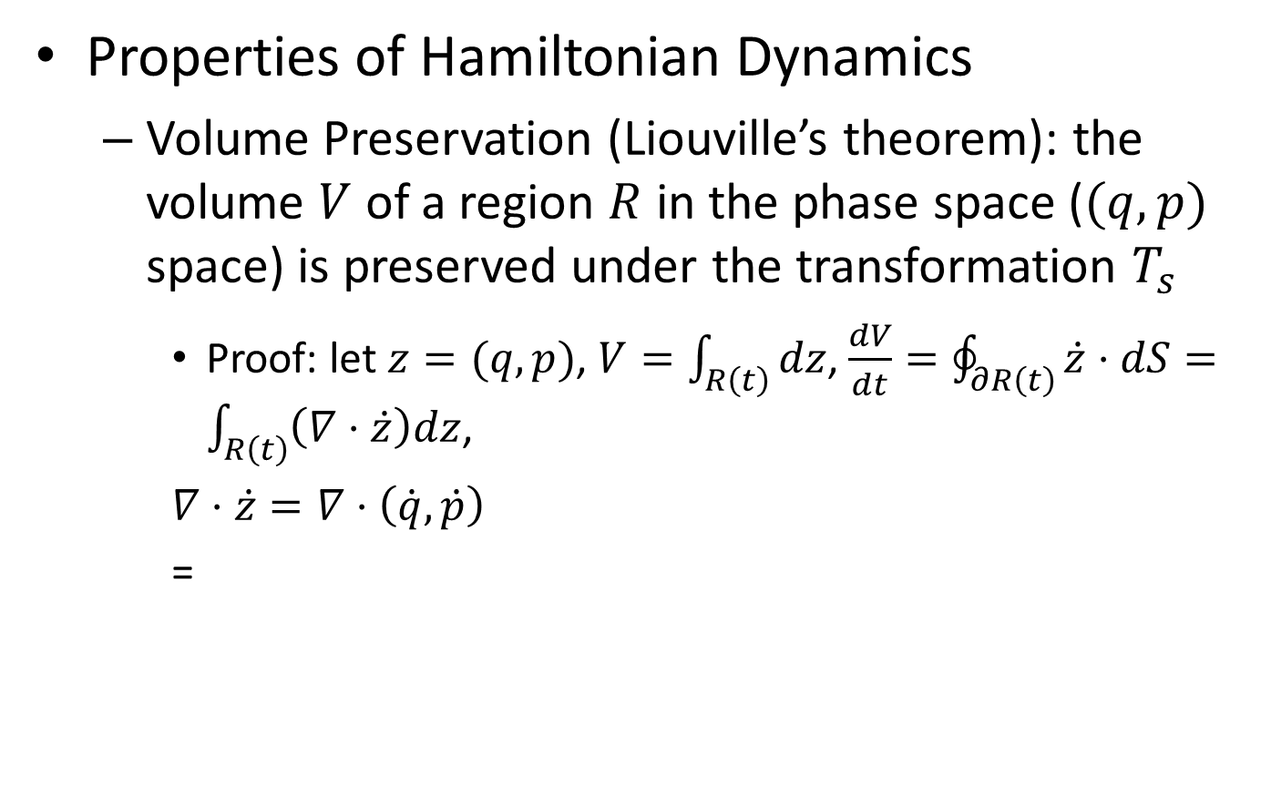
Hamiltonian Dynamics
Properties of Hamiltonian Dynamics
Volume Preservation (Liouville’s theorem): the volume $V$ of a region $R$ in the phase space ($(q,p)$ space) is preserved under the transformation $T_{s}$
Proof: let $z=(q,p)$, $V=\int_{R\left(t\right)}{dz}$, $\frac{dV}{dt}=\oint_{∂R\left(t\right)}{\dot{z}⋅dS}=\int_{R\left(t\right)}{\left(∇⋅\dot{z}\right)dz}$,
$∇⋅\dot{z}=∇⋅\left(\dot{q},\dot{p}\right)$
=

Slide 11
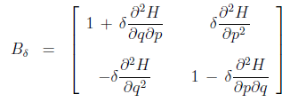

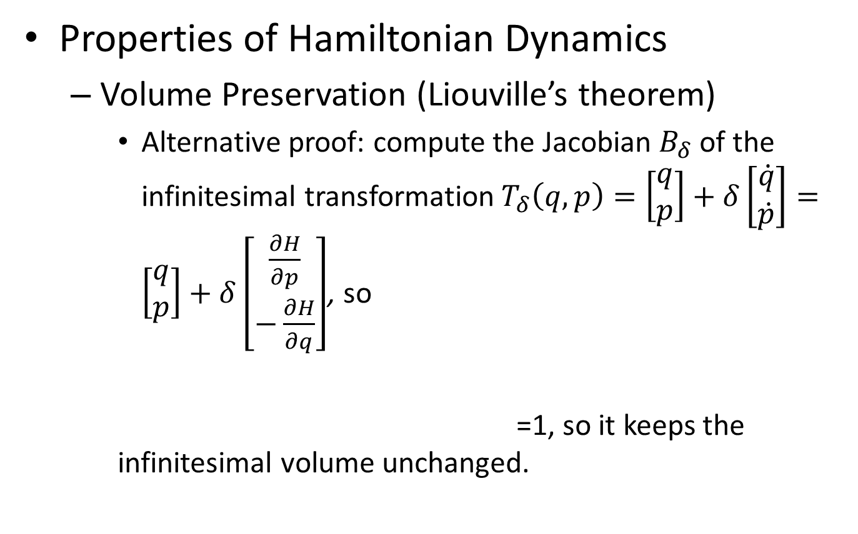
Hamiltonian Dynamics
Properties of Hamiltonian Dynamics
Volume Preservation (Liouville’s theorem)
Alternative proof: compute the Jacobian $B_{δ}$ of the infinitesimal transformation $T_{δ}\left(q,p\right)=\left[\begin{aligned}q \\ p\end{aligned}\right]+δ\left[\begin{aligned}\dot{q} \\ \dot{p}\end{aligned}\right]=\left[\begin{aligned}q \\ p\end{aligned}\right]+δ\left[\begin{aligned}\frac{∂H}{∂p} \\ −\frac{∂H}{∂q}\end{aligned}\right]$, so
=1, so it keeps the infinitesimal volume unchanged.

Slide 12
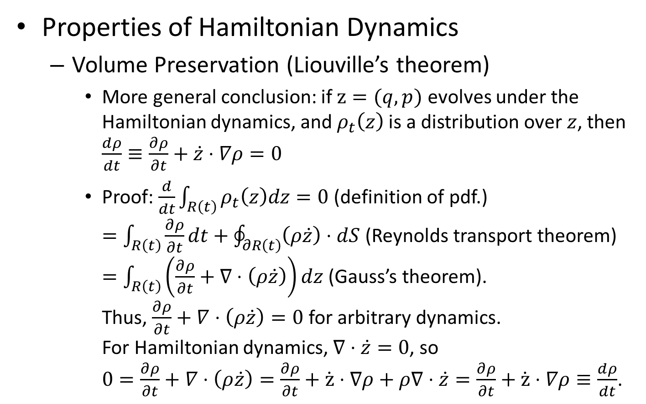
Hamiltonian Dynamics
Properties of Hamiltonian Dynamics
Volume Preservation (Liouville’s theorem)
More general conclusion: if $z=(q,p)$ evolves under the Hamiltonian dynamics, and $ρ_{t}\left(z\right)$ is a distribution over $z$, then $\frac{dρ}{dt}≡\frac{∂ρ}{∂t}+\dot{z}⋅∇ρ=0$
Proof: $\frac{d}{dt}\int_{R\left(t\right)}{ρ_{t}\left(z\right)dz}=0$ (definition of pdf.) $=\int_{R\left(t\right)}{\frac{∂ρ}{∂t}dt}+\oint_{∂R\left(t\right)}{\left(ρ\dot{z}\right)⋅dS}$ (Reynolds transport theorem) $=\int_{R\left(t\right)}{\left(\frac{∂ρ}{∂t}+∇⋅\left(ρ\dot{z}\right)\right)dz}$ (Gauss’s theorem). Thus, $\frac{∂ρ}{∂t}+∇⋅\left(ρ\dot{z}\right)=0$ for arbitrary dynamics. For Hamiltonian dynamics, $∇⋅\dot{z}=0$, so $0=\frac{∂ρ}{∂t}+∇⋅\left(ρ\dot{z}\right)=\frac{∂ρ}{∂t}+\dot{z}⋅∇ρ+ρ∇⋅\dot{z}=\frac{∂ρ}{∂t}+\dot{z}⋅∇ρ≡\frac{dρ}{dt}$.

Slide 13
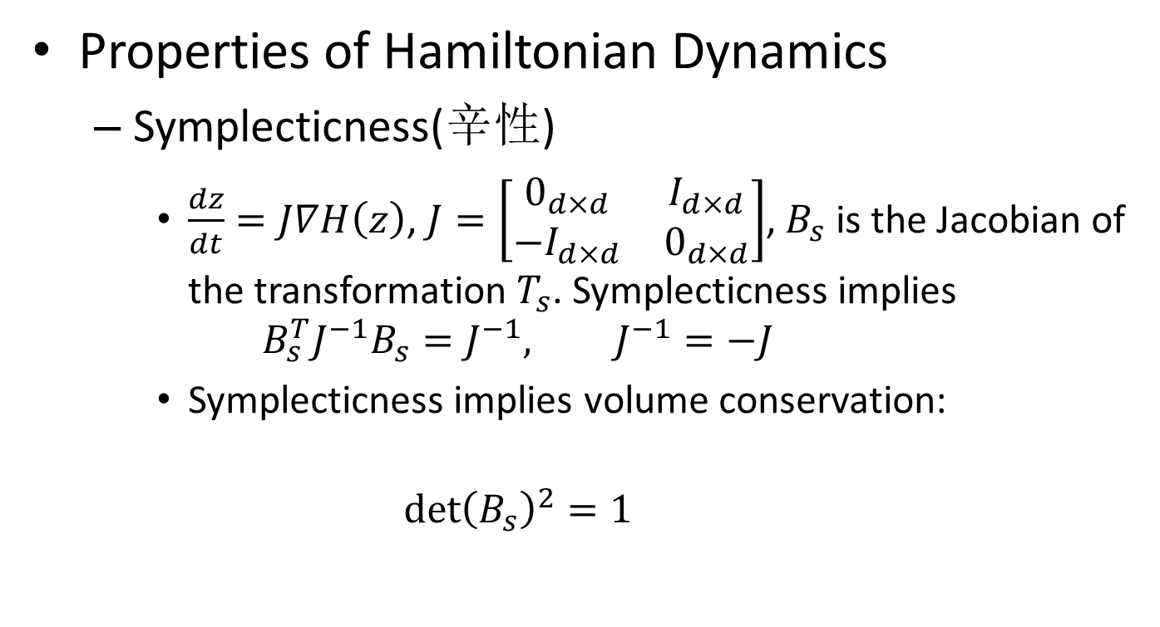
Hamiltonian Dynamics
Properties of Hamiltonian Dynamics
Symplecticness(辛性)
$\frac{dz}{dt}=J∇H\left(z\right)$, $J=\left[\begin{matrix}0_{d×d} & I_{d×d} \\ −I_{d×d} & 0_{d×d}\end{matrix}\right]$, $B_{s}$ is the Jacobian of the transformation $T_{s}$. Symplecticness implies
$$B_{s}^{T}J^{−1}B_{s}=J^{−1}, J^{−1}=−J$$
Symplecticness implies volume conservation:
$${\det\left(B_{s}\right)}^{2}=1$$

Slide 14
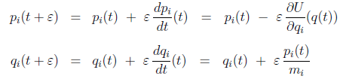
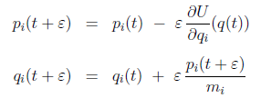
Hamiltonian Dynamics
Discretized methods for computing Hamiltonian evolution
Euler’s method
Cannot preserve volume
Modified Euler’s method
Volume conversation is guaranteed. (“Shear” transformation: update of one variable does not depend on the other, so the Jacobian is triangular.)

Slide 15
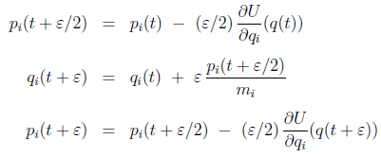
Hamiltonian Dynamics
Discretized methods for computing Hamiltonian evolution
The leapfrog method
Preserves volume (each is a “shear” transformation)

Slide 16
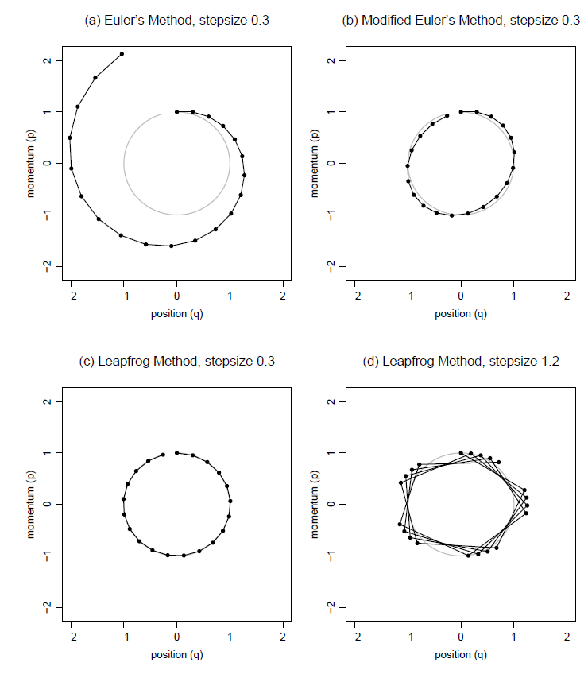
Hamiltonian Dynamics
Discretized methods for computing Hamiltonian evolution

Slide 17
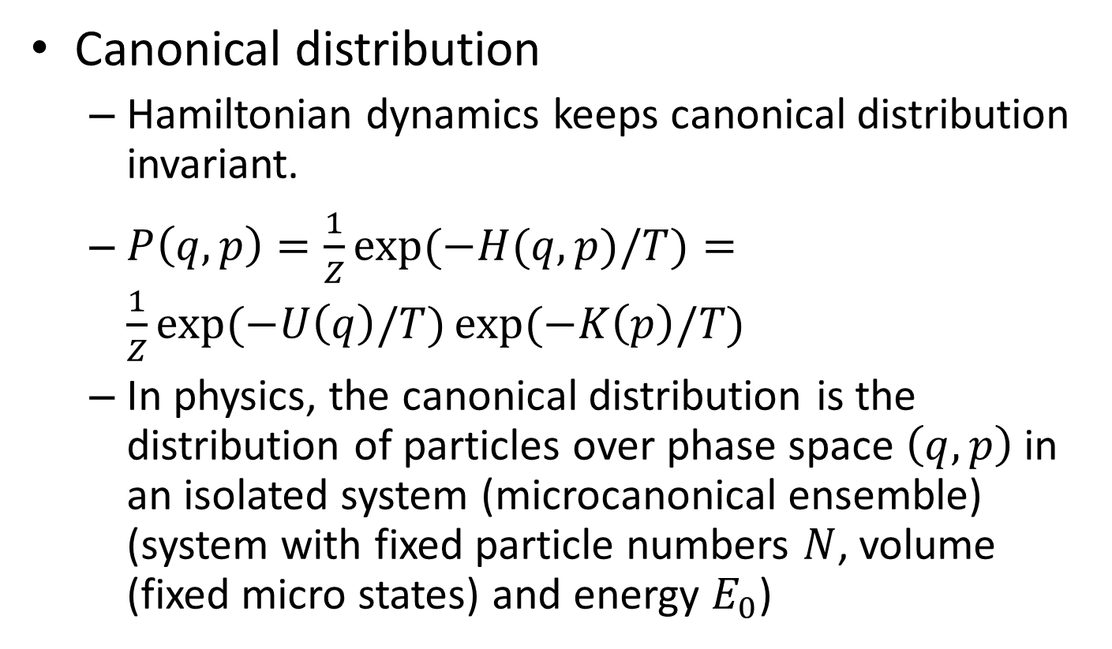
MCMC from Hamiltonian dynamics
Canonical distribution
Hamiltonian dynamics keeps canonical distribution invariant.
$P\left(q,p\right)=\frac{1}{Z}\exp{(−H(q,p)/T)}=\frac{1}{Z}\exp{(−U\left(q\right)/T)}\exp{(−K\left(p\right)/T)}$
In physics, the canonical distribution is the distribution of particles over phase space $\left(q,p\right)$ in an isolated system (microcanonical ensemble) (system with fixed particle numbers $N$, volume (fixed micro states) and energy $E_{0}$)

Slide 18
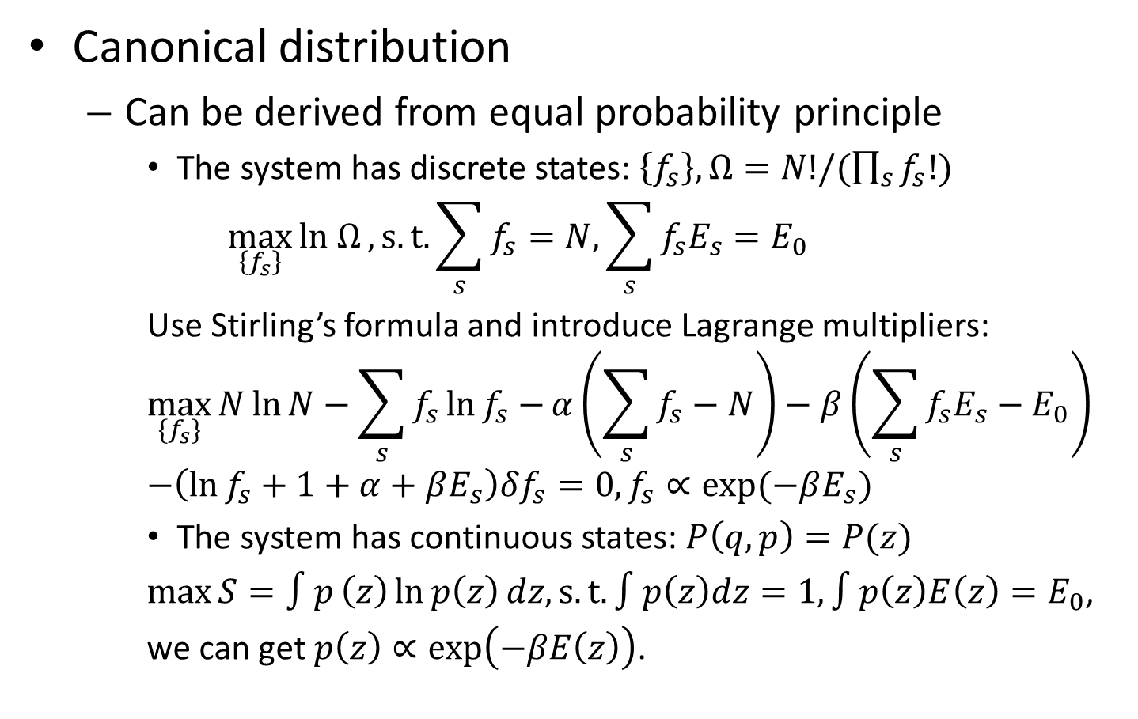
MCMC from Hamiltonian dynamics
Canonical distribution
Can be derived from equal probability principle
The system has discrete states: $\left\{f_{s}\right\}, Ω=N!/(\prod_{s}{f_{s}!})$
$$\max_{\left\{f_{s}\right\}}{ln Ω},s.t. \sum_{s}{f_{s}}=N,\sum_{s}{f_{s}E_{s}}=E_{0}$$
Use Stirling’s formula and introduce Lagrange multipliers:
$$\max_{{\{f}_{s}\}}{N\ln{N}−\sum_{s}{f_{s}\ln{f_{s}}}−}α\left(\sum_{s}{f_{s}}−N\right)−β\left(\sum_{s}{f_{s}E_{s}}−E_{0}\right) \\ −\left(\ln{f_{s}}+1+α+βE_{s}\right)δf_{s}=0, f_{s}∝\exp{(−βE_{s})}$$
The system has continuous states: $P\left(q,p\right)=P(z)$
$\max{S=∫p}\left(z\right)\ln{p\left(z\right)}dz, s.t. ∫p\left(z\right)dz=1, ∫p\left(z\right)E\left(z\right)=E_{0}$,
we can get $p\left(z\right)∝\exp\left(−βE\left(z\right)\right)$.

Slide 19
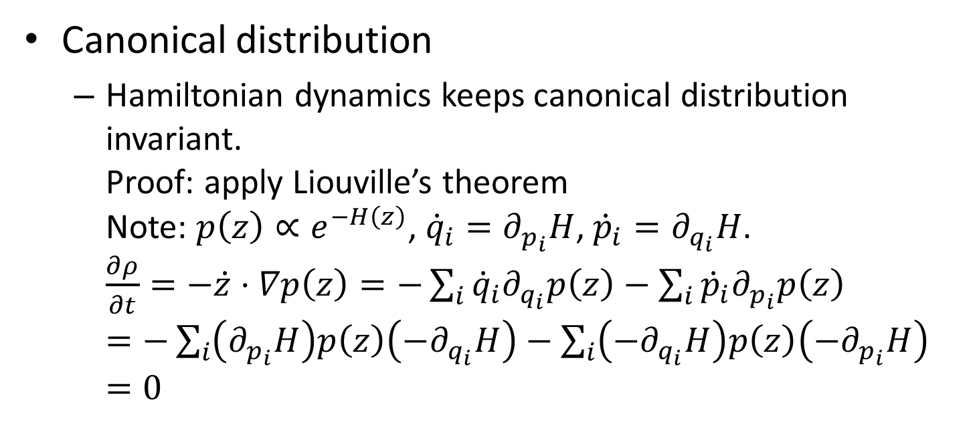
MCMC from Hamiltonian dynamics
Canonical distribution
Hamiltonian dynamics keeps canonical distribution invariant. Proof: apply Liouville’s theorem Note: $p\left(z\right)∝e^{−H\left(z\right)}$, ${\dot{q}}_{i}=∂_{p_{i}}H$, ${\dot{p}}_{i}=∂_{q_{i}}H$. $\frac{∂ρ}{∂t}=−\dot{z}⋅∇p\left(z\right)=−\sum_{i}{{\dot{q}}_{i}∂_{q_{i}}p\left(z\right)}−\sum_{i}{{\dot{p}}_{i}∂_{p_{i}}p\left(z\right)}$ $=−\sum_{i}{\left(∂_{p_{i}}H\right)p\left(z\right)\left(−∂_{q_{i}}H\right)}−\sum_{i}{\left(−∂_{q_{i}}H\right)p\left(z\right)\left(−∂_{p_{i}}H\right)}$ $=0$

Slide 20
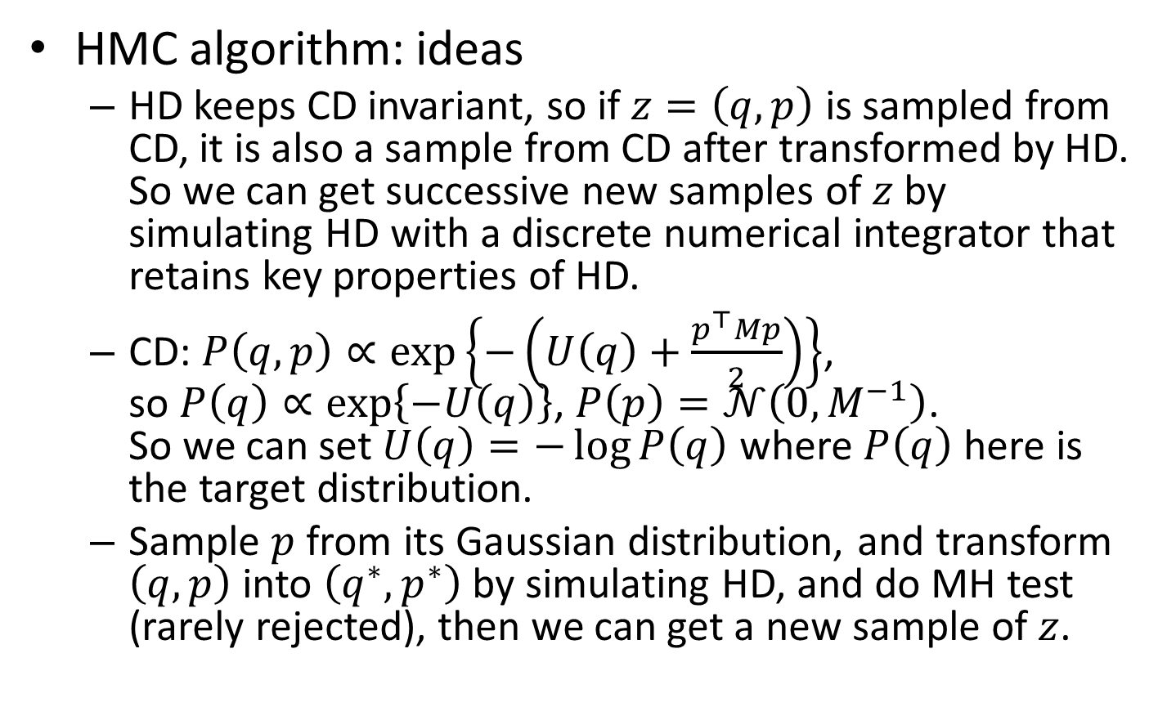
MCMC from Hamiltonian dynamics
HMC algorithm: ideas
HD keeps CD invariant, so if $z=\left(q,p\right)$ is sampled from CD, it is also a sample from CD after transformed by HD. So we can get successive new samples of $z$ by simulating HD with a discrete numerical integrator that retains key properties of HD.
CD: $P\left(q,p\right)∝\exp\left\{−\left(U\left(q\right)+\frac{p^{⊤}Mp}{2}\right)\right\}$, so $P\left(q\right)∝\exp\left\{−U\left(q\right)\right\}$, $P\left(p\right)=𝒩\left(0,M^{−1}\right)$. So we can set $U\left(q\right)=−\log{P\left(q\right)}$ where $P\left(q\right)$ here is the target distribution.
Sample $p$ from its Gaussian distribution, and transform $\left(q,p\right)$ into $\left(q^{∗},p^{∗}\right)$ by simulating HD, and do MH test (rarely rejected), then we can get a new sample of $z$.

Slide 21
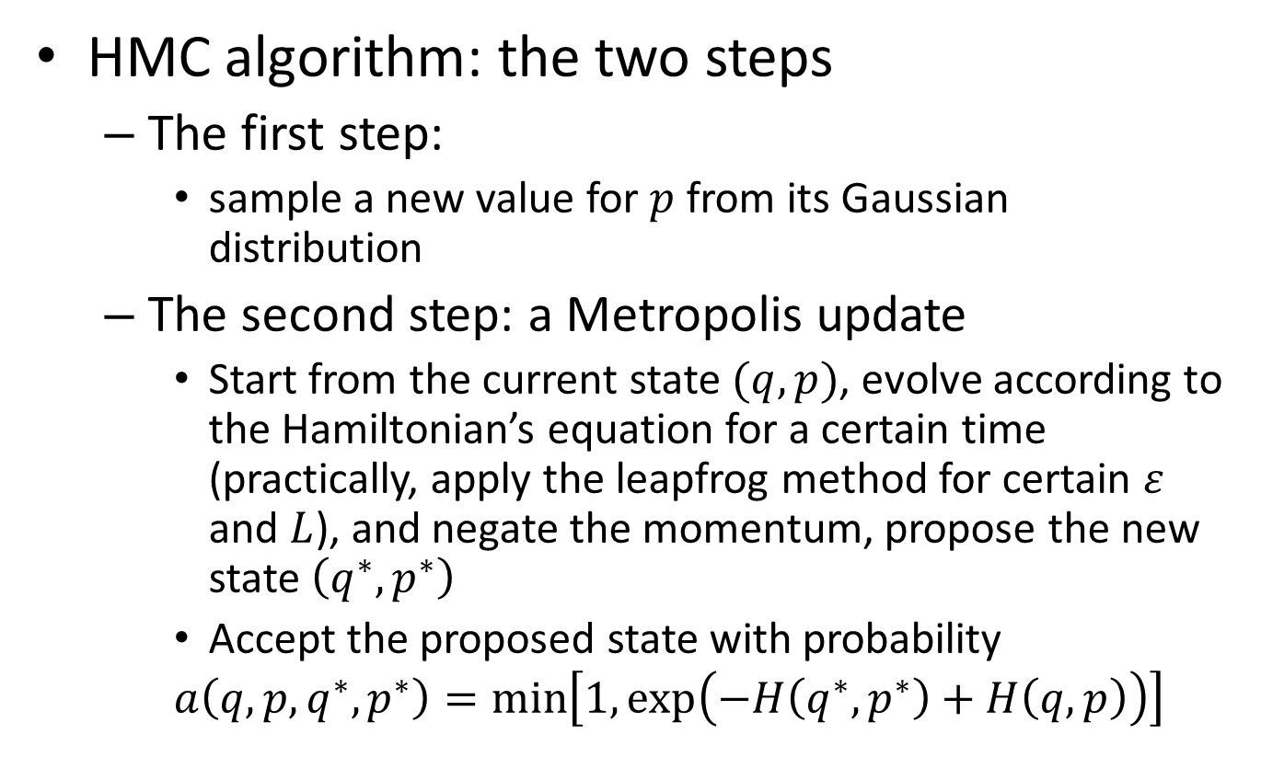
MCMC from Hamiltonian dynamics
HMC algorithm: the two steps
The first step:
sample a new value for $p$ from its Gaussian distribution
The second step: a Metropolis update
Start from the current state $(q,p)$, evolve according to the Hamiltonian’s equation for a certain time (practically, apply the leapfrog method for certain $ε$ and $L$), and negate the momentum, propose the new state $\left(q^{∗},p^{∗}\right)$
Accept the proposed state with probability
$$a\left(q,p,q^{∗},p^{∗}\right)=\min\left[1,\exp\left(−H\left(q^{∗},p^{∗}\right)+H\left(q,p\right)\right)\right]$$

Slide 22
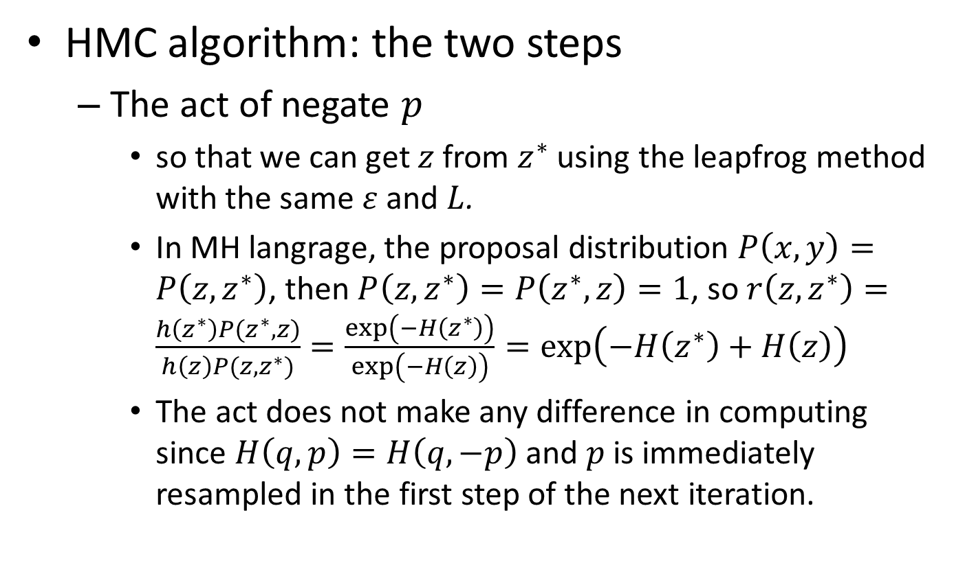
MCMC from Hamiltonian dynamics
HMC algorithm: the two steps
The act of negate $p$
so that we can get $z$ from $z^{∗}$ using the leapfrog method with the same $ε$ and $L$.
In MH langrage, the proposal distribution $P\left(x,y\right)=P\left(z,z^{∗}\right)$, then $P\left(z,z^{∗}\right)=P\left(z^{∗},z\right)=1$, so $r\left(z,z^{∗}\right)=\frac{h\left(z^{∗}\right)P(z^{∗},z)}{h\left(z\right)P(z,z^{∗})}=\frac{\exp\left(−H\left(z^{∗}\right)\right)}{\exp\left(−H\left(z\right)\right)}=\exp\left(−H\left(z^{∗}\right)+H\left(z\right)\right)$
The act does not make any difference in computing since $H\left(q,p\right)=H\left(q,−p\right)$ and $p$ is immediately resampled in the first step of the next iteration.

Slide 23
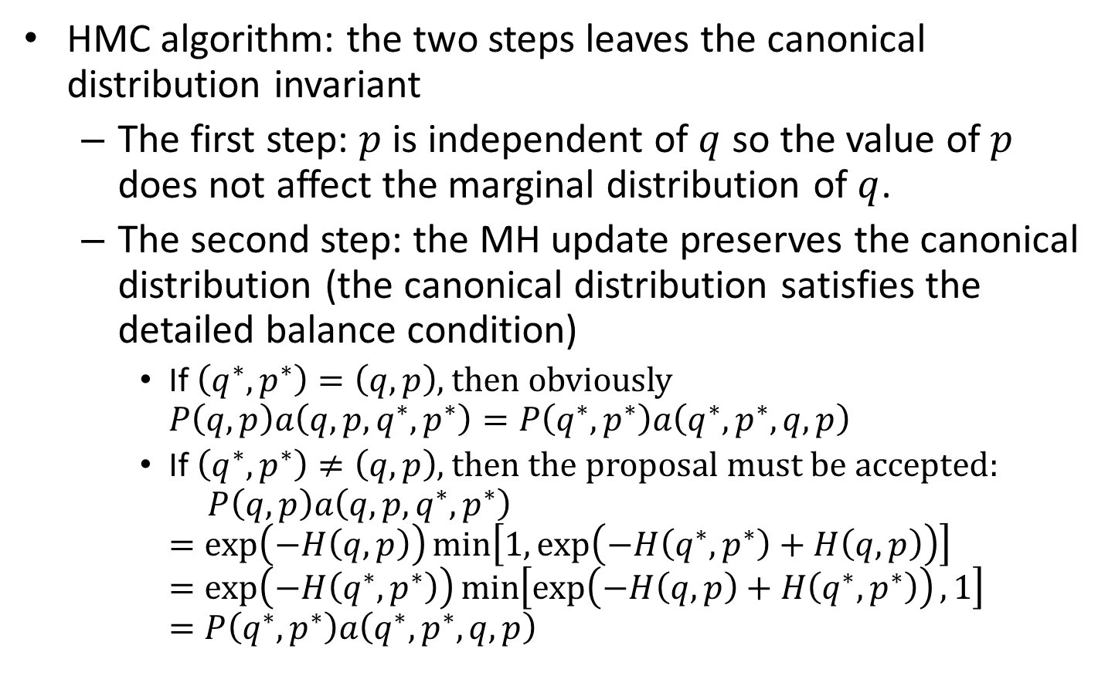
MCMC from Hamiltonian dynamics
HMC algorithm: the two steps leaves the canonical distribution invariant
The first step: $p$ is independent of $q$ so the value of $p$ does not affect the marginal distribution of $q$.
The second step: the MH update preserves the canonical distribution (the canonical distribution satisfies the detailed balance condition)
If $\left(q^{∗},p^{∗}\right)=\left(q,p\right)$, then obviously $P\left(q,p\right)a\left(q,p,q^{∗},p^{∗}\right)=P\left(q^{∗},p^{∗}\right)a\left(q^{∗},p^{∗},q,p\right)$
If $\left(q^{∗},p^{∗}\right)≠\left(q,p\right)$, then the proposal must be accepted: $P\left(q,p\right)a\left(q,p,q^{∗},p^{∗}\right)$ $=\exp\left(−H\left(q,p\right)\right)\min\left[1,\exp\left(−H\left(q^{∗},p^{∗}\right)+H\left(q,p\right)\right)\right]$ $=\exp\left(−H\left(q^{∗},p^{∗}\right)\right)\min\left[\exp\left(−H\left(q,p\right)+H\left(q^{∗},p^{∗}\right)\right),1\right]$ $=P\left(q^{∗},p^{∗}\right)a\left(q^{∗},p^{∗},q,p\right)$

Slide 24

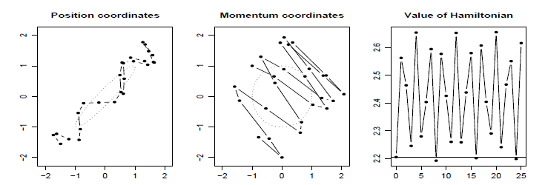

Illustrations of HMC and its benefits
Trajectories for a 2-d problem
Sampling from a bivariate Gaussian with zero mean
Trajectory different from RW, along the valley
$ε$ affects the oscillation of the Hamiltonian: larger values may cause instability; smaller values may keep the oscillation bounded for arbitrarily large $L$
Notes:
Diff from random walk; travel along the axis

Slide 25
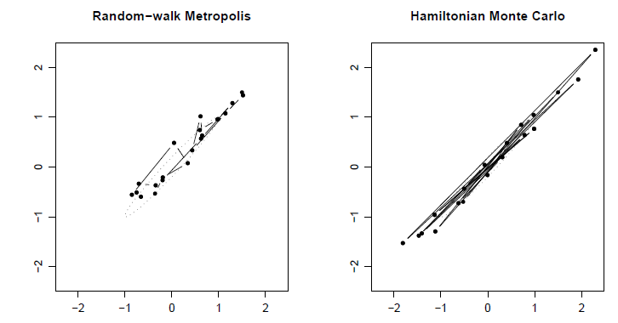
Illustrations of HMC and its benefits
Sample from a 2-d distribution
20 iterates each with 20 updates
Rejection rate: 0.37 vs. 0.09 (parameter s.t. comparable change in state for every iteration)

Slide 26
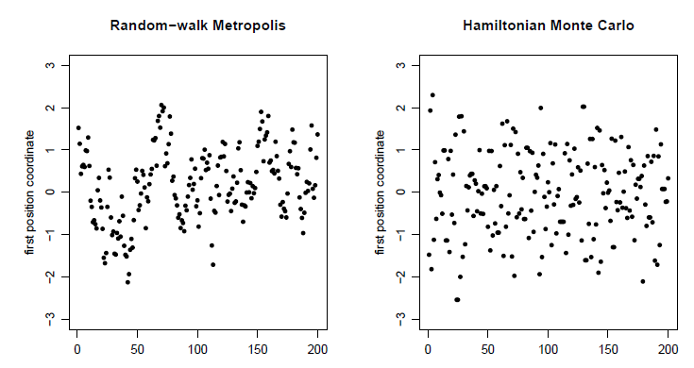
Illustrations of HMC and its benefits
Sample from a 2-d distribution
200 trajectories of the first coordinate

Slide 27
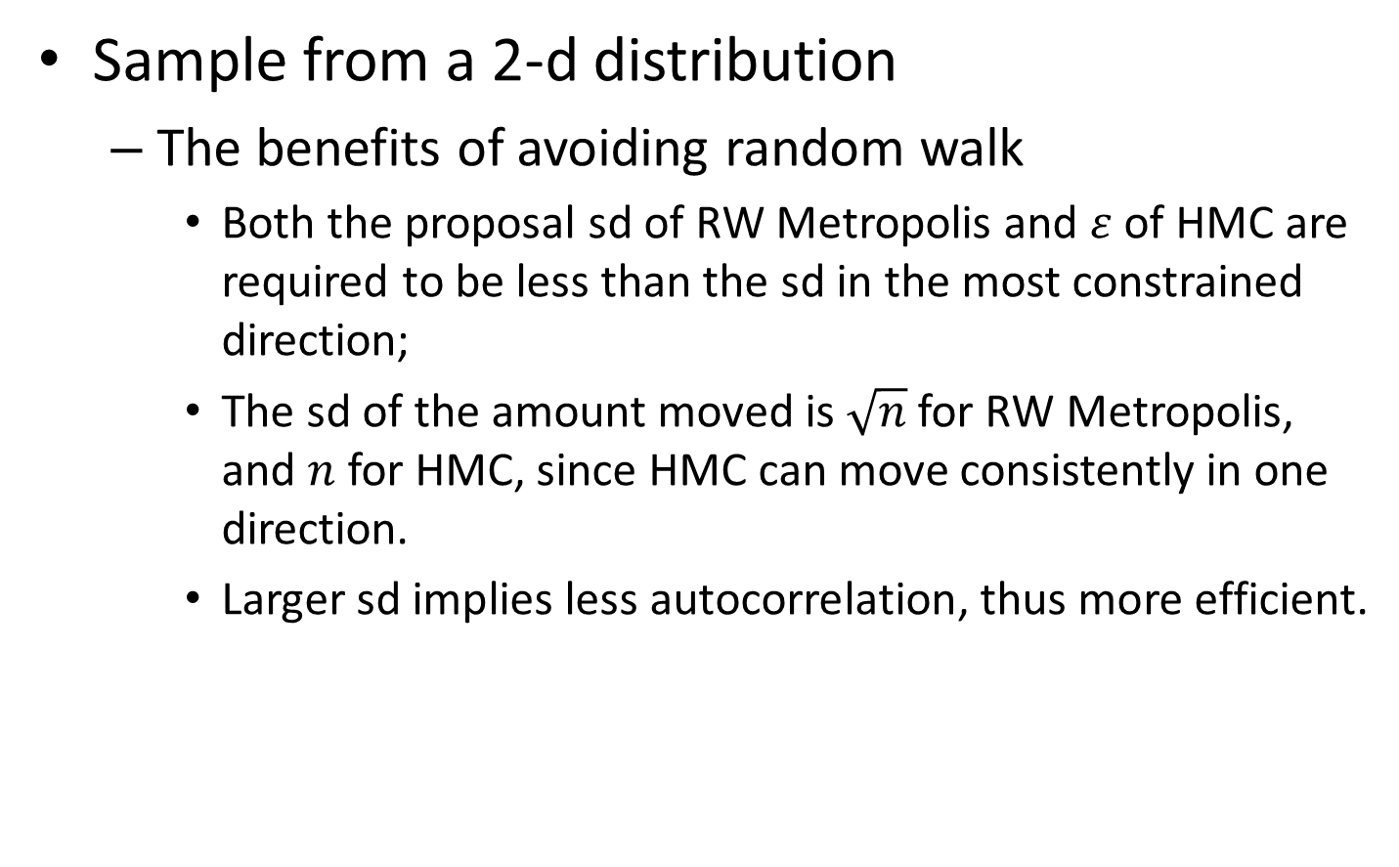
Illustrations of HMC and its benefits
Sample from a 2-d distribution
The benefits of avoiding random walk
Both the proposal sd of RW Metropolis and $ε$ of HMC are required to be less than the sd in the most constrained direction;
The sd of the amount moved is $\sqrt{n}$ for RW Metropolis, and $n$ for HMC, since HMC can move consistently in one direction.
Larger sd implies less autocorrelation, thus more efficient.

Slide 28
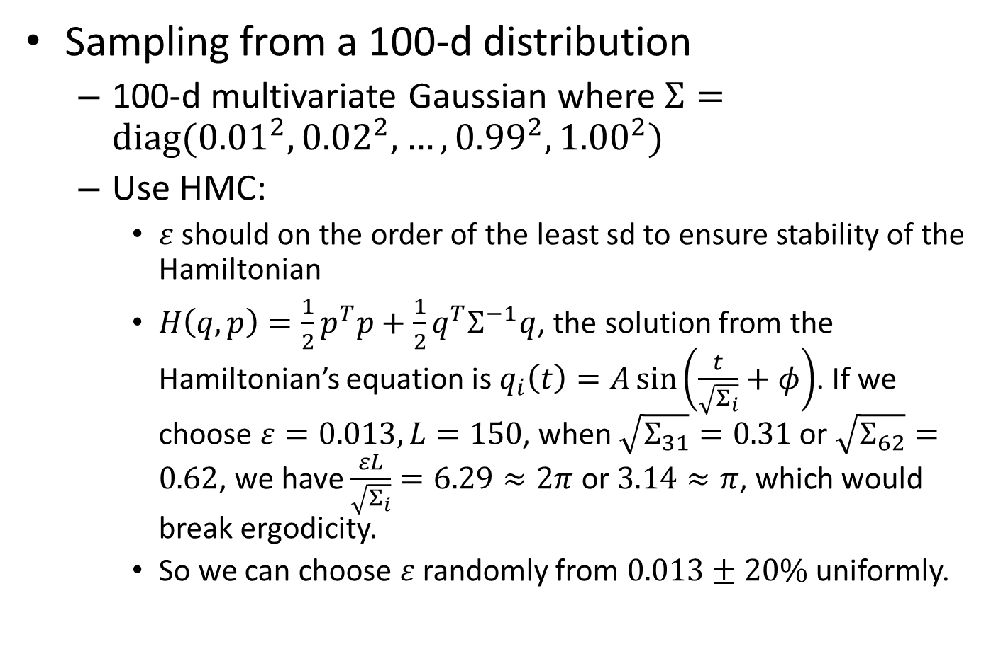
Illustrations of HMC and its benefits
Sampling from a 100-d distribution
100-d multivariate Gaussian where $Σ=diag({0.01}^{2},{0.02}^{2},…,{0.99}^{2},{1.00}^{2})$
Use HMC:
$ε$ should on the order of the least sd to ensure stability of the Hamiltonian
$H\left(q,p\right)=\frac{1}{2}p^{T}p+\frac{1}{2}q^{T}Σ^{−1}q$, the solution from the Hamiltonian’s equation is $q_{i}\left(t\right)=A\sin\left(\frac{t}{\sqrt{Σ_{i}}}+φ\right)$. If we choose $ε=0.013,L=150$, when $\sqrt{Σ_{31}}=0.31$ or $\sqrt{Σ_{62}}=0.62$, we have $\frac{εL}{\sqrt{Σ_{i}}}=6.29≈2π$ or $3.14≈π$, which would break ergodicity.
So we can choose $ε$ randomly from $0.013±20\%$ uniformly.

Slide 29
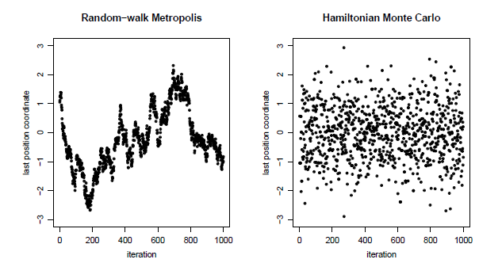
Illustrations of HMC and its benefits
Sampling from a 100-d distribution

Slide 30
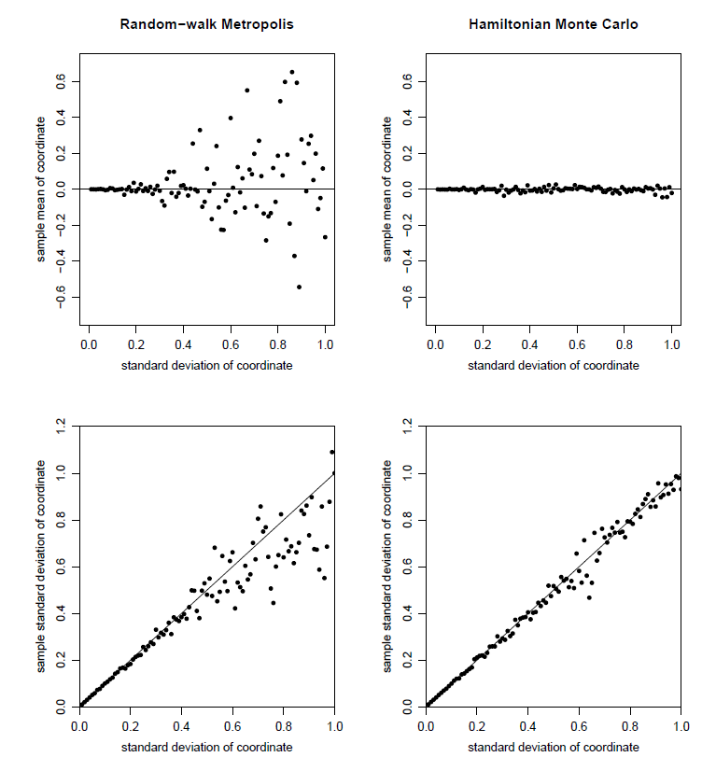
Illustrations of HMC and its benefits
Sampling from a 100-d distribution

Slide 31
Riemann manifold Langevin and Hamiltonian Monte Carlo methods (Girolami & Calderhead, 2011)
Overview
Riemann manifold
Derivation of RMHMC
Discrete numerical integrator for RMHMC
Experimental results

Slide 32
Overview
Set the mass matrix automatically to be the Fisher information matrix (Fisher-Rao metric tensor) to explore the geometry of the parameter space.
The Hamiltonian and thus the canonical distribution is no longer separable, so the numerical integrator is updated as the generalized leap frog algorithm, which calls for solving implicit equations with iteration.

Slide 33
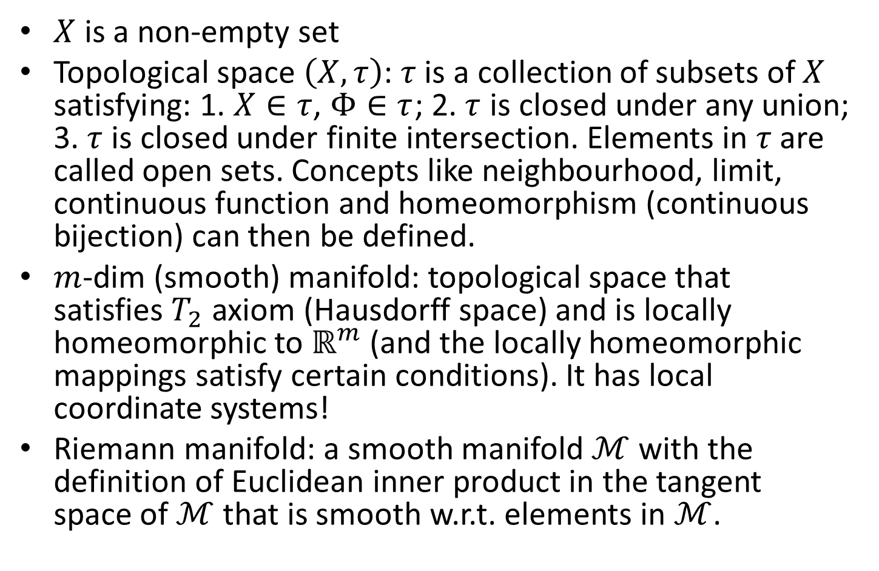
Riemann Manifold
$X$ is a non-empty set
Topological space $\left(X, τ\right)$: $τ$ is a collection of subsets of $X$ satisfying: 1. $X∈τ$, $Φ∈τ$; 2. $τ$ is closed under any union; 3. $τ$ is closed under finite intersection. Elements in $τ$ are called open sets. Concepts like neighbourhood, limit, continuous function and homeomorphism (continuous bijection) can then be defined.
$m$-dim (smooth) manifold: topological space that satisfies $T_{2}$ axiom (Hausdorff space) and is locally homeomorphic to $ℝ^{m}$ (and the locally homeomorphic mappings satisfy certain conditions). It has local coordinate systems!
Riemann manifold: a smooth manifold $ℳ$ with the definition of Euclidean inner product in the tangent space of $ℳ$ that is smooth w.r.t. elements in $ℳ$.

Slide 34
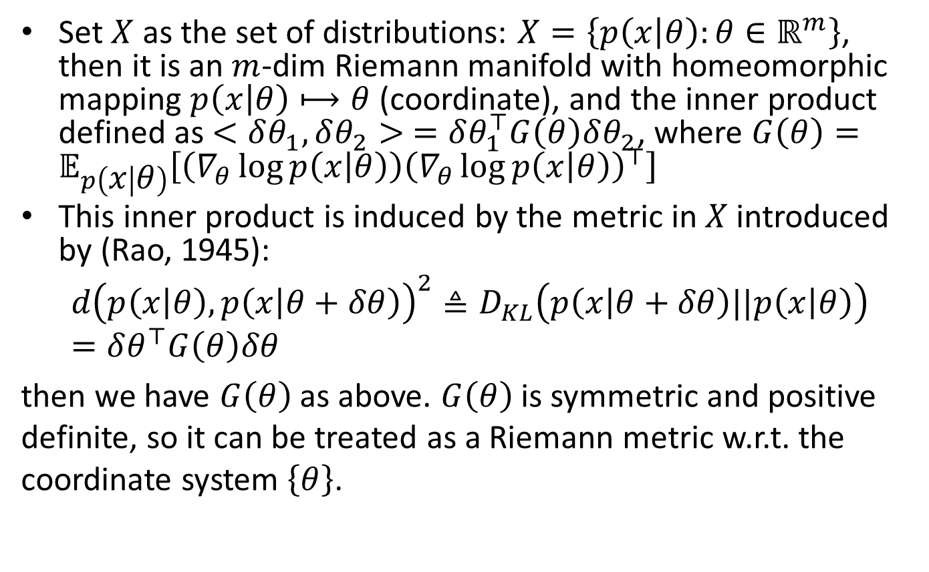
Riemann Manifold
Set $X$ as the set of distributions: $X=\left\{p\left(x | θ\right):θ∈ℝ^{m}\right\}$, then it is an $m$-dim Riemann manifold with homeomorphic mapping $p\left(x | θ\right)⟼θ$ (coordinate), and the inner product defined as $<δθ_{1},δθ_{2}> =δθ_{1}^{⊤}G\left(θ\right)δθ_{2}$, where $G\left(θ\right)=𝔼_{p\left(x | θ\right)}\left[\left(∇_{θ}\log{p\left(x | θ\right)}\right){\left(∇_{θ}\log{p\left(x | θ\right)}\right)}^{⊤}\right]$
This inner product is induced by the metric in $X$ introduced by (Rao, 1945):
$$d{\left(p\left(x | θ\right),p\left(x | θ+δθ\right)\right)}^{2}≜D_{KL}\left(p\left(x | θ+δθ\right)||p\left(x | θ\right)\right)=δθ^{⊤}G\left(θ\right)δθ$$ then we have $G\left(θ\right)$ as above. $G\left(θ\right)$ is symmetric and positive definite, so it can be treated as a Riemann metric w.r.t. the coordinate system $\left\{θ\right\}$.

Slide 35
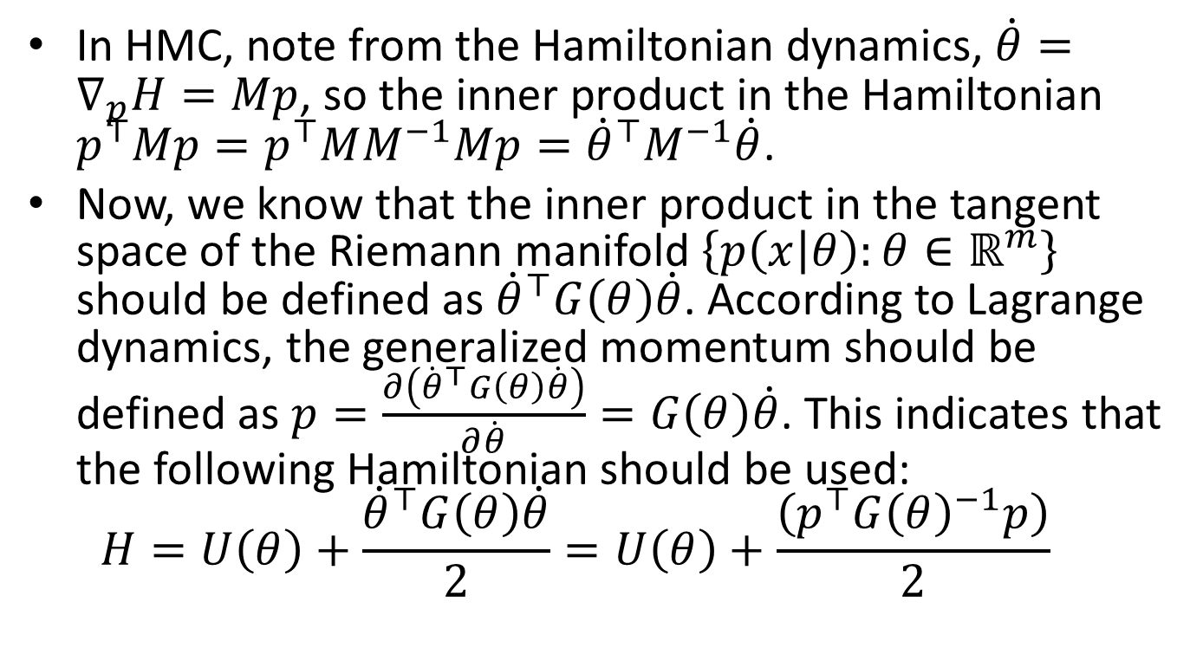
Derivation of RMHMC
In HMC, note from the Hamiltonian dynamics, $\dot{θ}=∇_{p}H=Mp$, so the inner product in the Hamiltonian $p^{⊤}Mp=p^{⊤}MM^{−1}Mp={\dot{θ}}^{⊤}M^{−1}\dot{θ}$.
Now, we know that the inner product in the tangent space of the Riemann manifold $\left\{p\left(x | θ\right):θ∈ℝ^{m}\right\}$ should be defined as ${\dot{θ}}^{⊤}G\left(θ\right)\dot{θ}$. According to Lagrange dynamics, the generalized momentum should be defined as $p=\frac{∂\left({\dot{θ}}^{⊤}G\left(θ\right)\dot{θ}\right)}{∂\dot{θ}}=G\left(θ\right)\dot{θ}$. This indicates that the following Hamiltonian should be used: $H=U\left(θ\right)+\frac{{\dot{θ}}^{⊤}G\left(θ\right)\dot{θ}}{2}=U\left(θ\right)+\frac{\left(p^{⊤}G{\left(θ\right)}^{−1}p\right)}{2}$

Slide 36
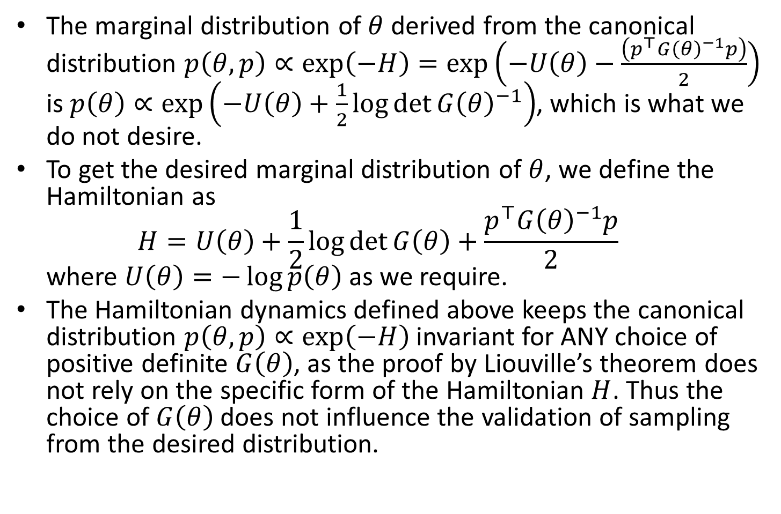
Derivation of RMHMC
The marginal distribution of $θ$ derived from the canonical distribution $p\left(θ,p\right)∝\exp\left(−H\right)=\exp\left(−U\left(θ\right)−\frac{\left(p^{⊤}G{\left(θ\right)}^{−1}p\right)}{2}\right)$ is $p\left(θ\right)∝\exp\left(−U\left(θ\right)+\frac{1}{2}\log{\det{G{\left(θ\right)}^{−1}}}\right)$, which is what we do not desire.
To get the desired marginal distribution of $θ$, we define the Hamiltonian as $H=U\left(θ\right)+\frac{1}{2}\log{\det{G\left(θ\right)}}+\frac{p^{⊤}G{\left(θ\right)}^{−1}p}{2}$ where $U\left(θ\right)=−\log{p\left(θ\right)}$ as we require.
The Hamiltonian dynamics defined above keeps the canonical distribution $p\left(θ,p\right)∝\exp\left(−H\right)$ invariant for ANY choice of positive definite $G\left(θ\right)$, as the proof by Liouville’s theorem does not rely on the specific form of the Hamiltonian $H$. Thus the choice of $G\left(θ\right)$ does not influence the validation of sampling from the desired distribution.
Notes:
Illustrate the derivation of the proposed Hamiltonian by pure Lagrange and Hamiltonian dynamics in the embedded Euclidean space.

Slide 37
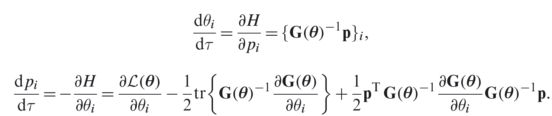
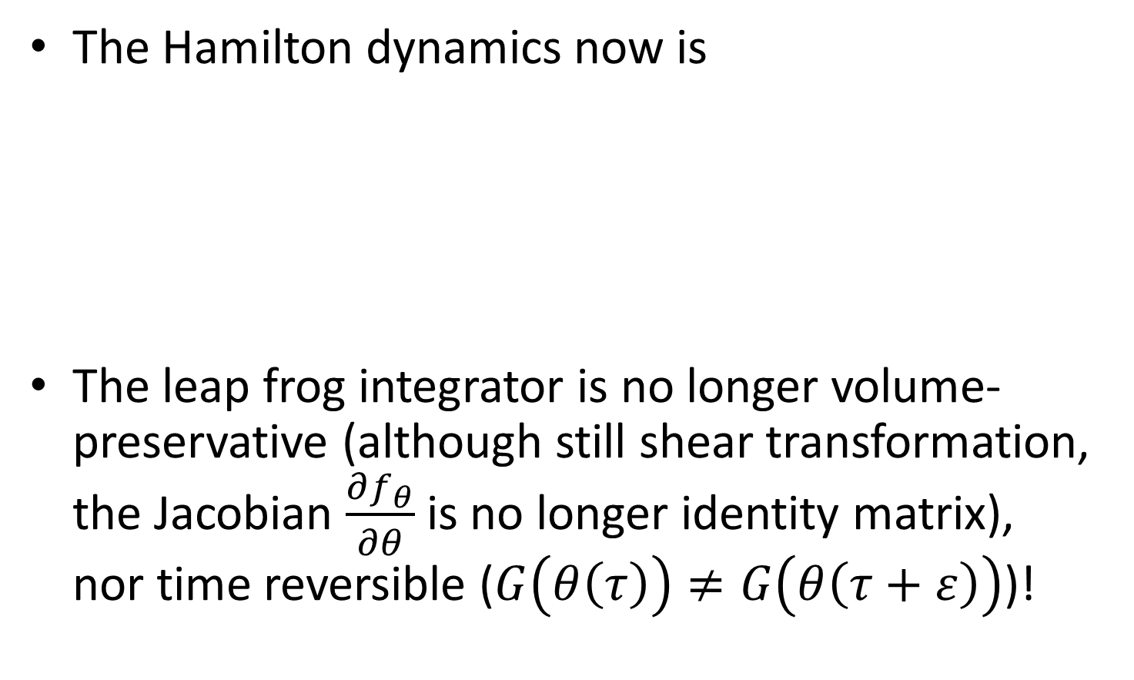
Discrete numerical integrator for RMHMC
The Hamilton dynamics now is
The leap frog integrator is no longer volume-preservative (although still shear transformation, the Jacobian $\frac{∂f_{θ}}{∂θ}$ is no longer identity matrix), nor time reversible ($G\left(θ\left(τ\right)\right)≠G\left(θ\left(τ+ε\right)\right)$)!

Slide 38
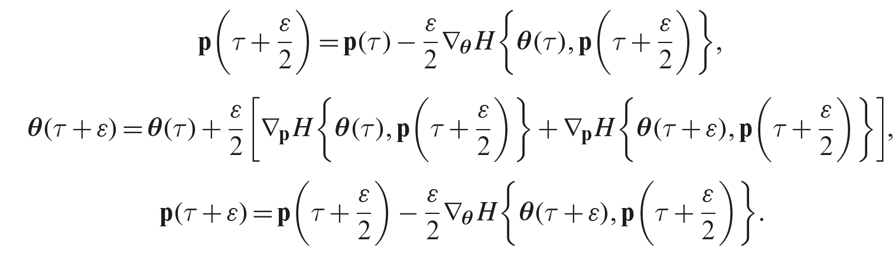

Discrete numerical integrator for RMHMC
The generalized leap frog method is introduced as with the first step solving $p\left(τ+\frac{ε}{2}\right)$, second solving $θ\left(τ+\frac{ε}{2}\right)$ and third solving $p\left(θ+ε\right)$, all in an implicit way. Iteration methods e.g. Newton methods are required.
Other operations (sample $p$ from Gaussian (with covariance matrix $G\left(θ\right)$), and MH test) remains the same as HMC.

Slide 39
Experimental results
HMC with unit mass matrix
RMHMC from the same starting point

Slide 40
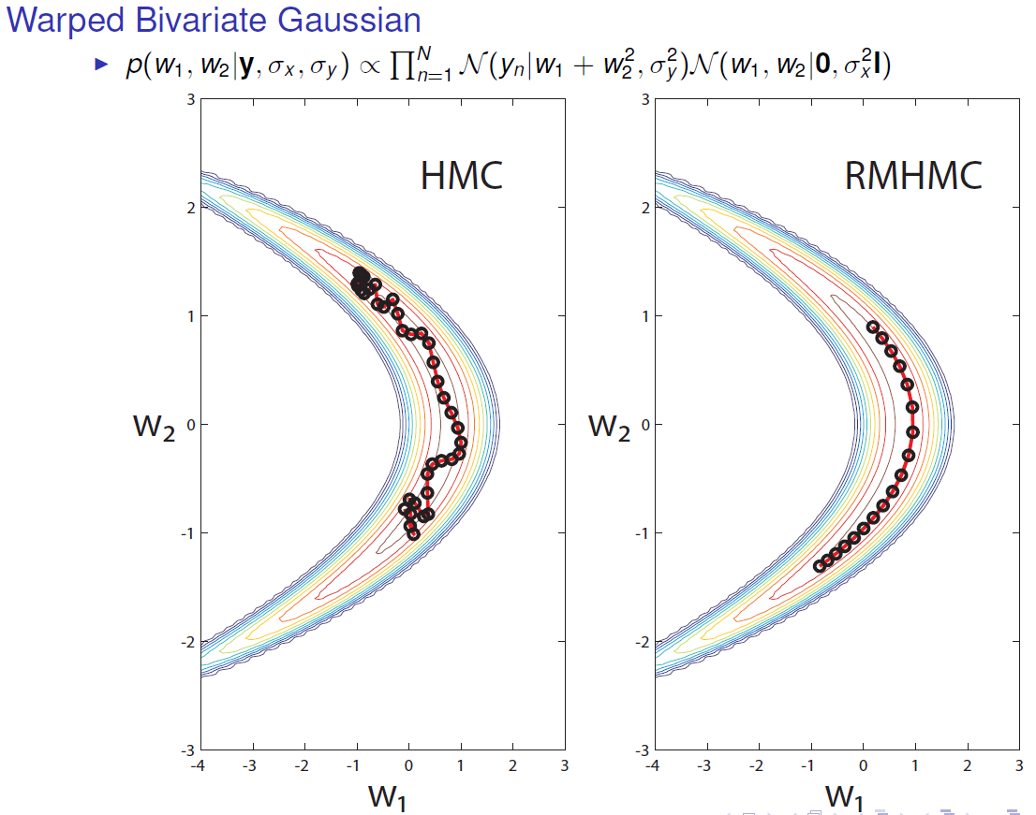
Experimental results
From: http://www.dcs.gla.ac.uk/inference/download2.cfm?f=RSS_Oct13_Giro.pdf&owner=11&referrer=rmhmc/index.html

Slide 41
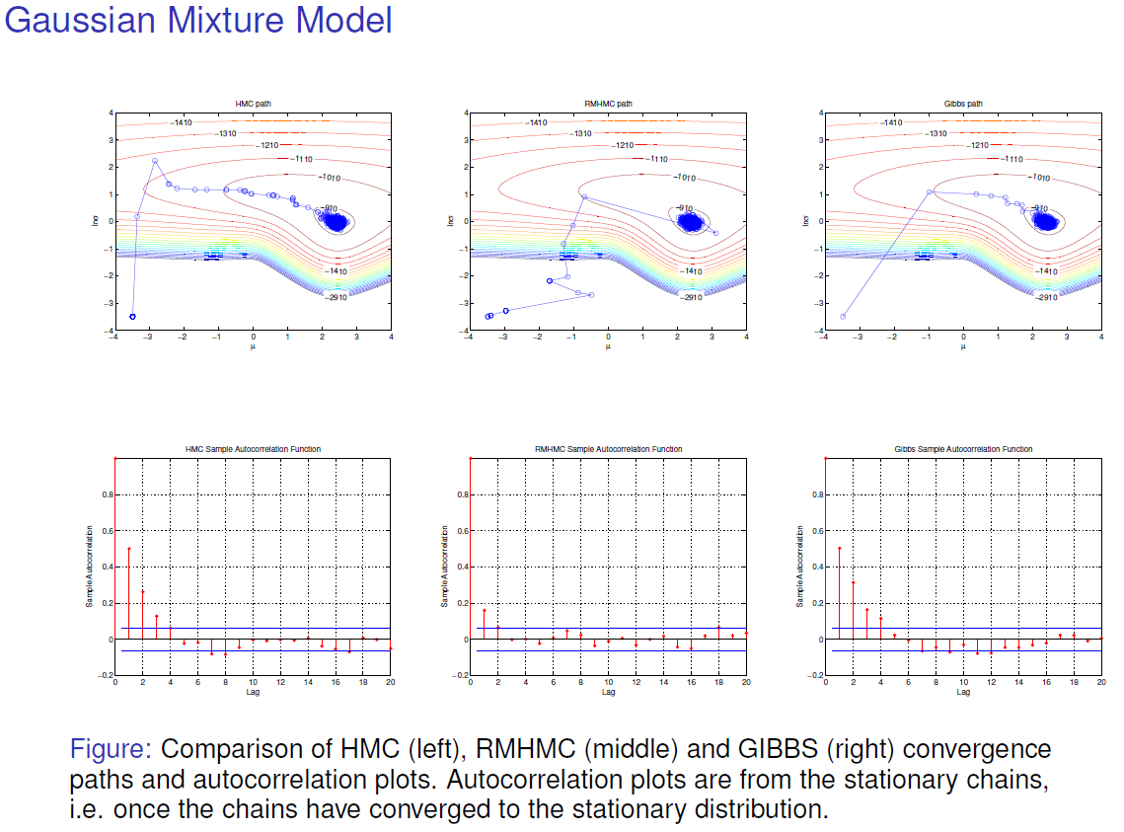
Experimental results
From: http://www.dcs.gla.ac.uk/inference/download2.cfm?f=RSS_Oct13_Giro.pdf&owner=11&referrer=rmhmc/index.html

Slide 42
Geodesic Monte Carlo on Embedded Manifolds (Byrne & Girolami, 2013)
Overview
Embedding
Derivation of Geodesic Monte Carlo
Discussions

Slide 43
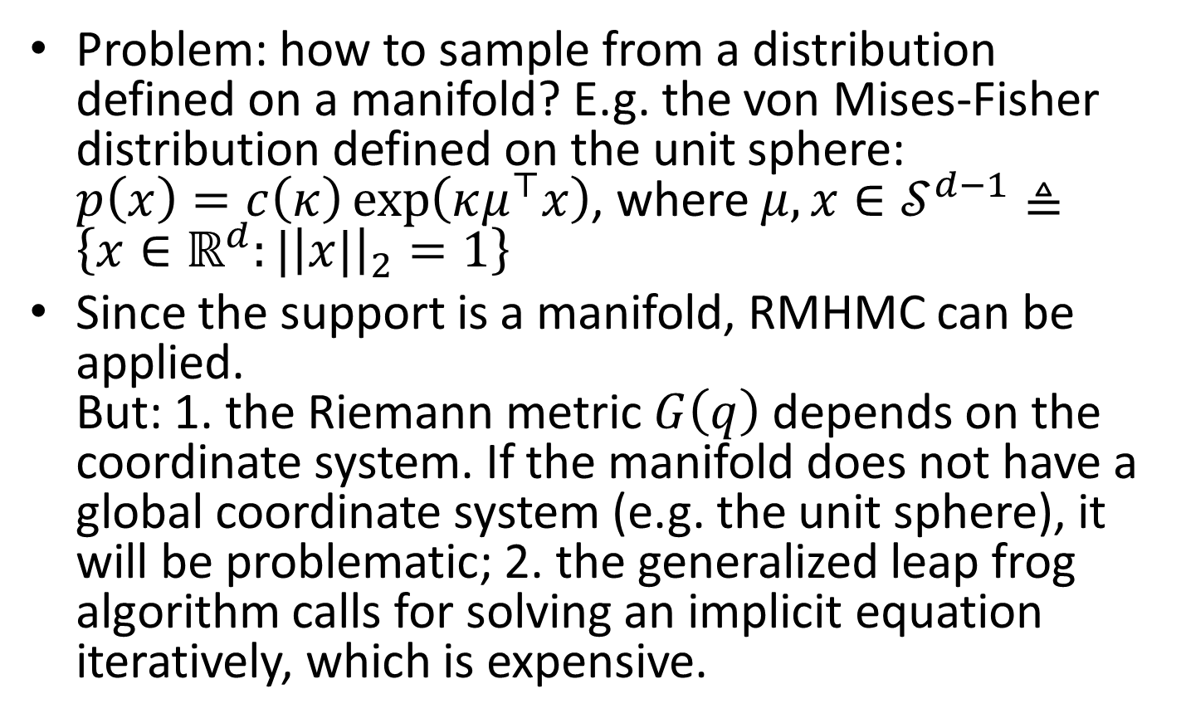
Overview
Problem: how to sample from a distribution defined on a manifold? E.g. the von Mises-Fisher distribution defined on the unit sphere: $p\left(x\right)=c\left(κ\right)\exp\left(κμ^{⊤}x\right)$, where $μ,x∈𝒮^{d−1}≜\left\{x∈ℝ^{d}:|{\left|x|\right|}_{2}=1\right\}$
Since the support is a manifold, RMHMC can be applied. But: 1. the Riemann metric $G\left(q\right)$ depends on the coordinate system. If the manifold does not have a global coordinate system (e.g. the unit sphere), it will be problematic; 2. the generalized leap frog algorithm calls for solving an implicit equation iteratively, which is expensive.

Slide 44
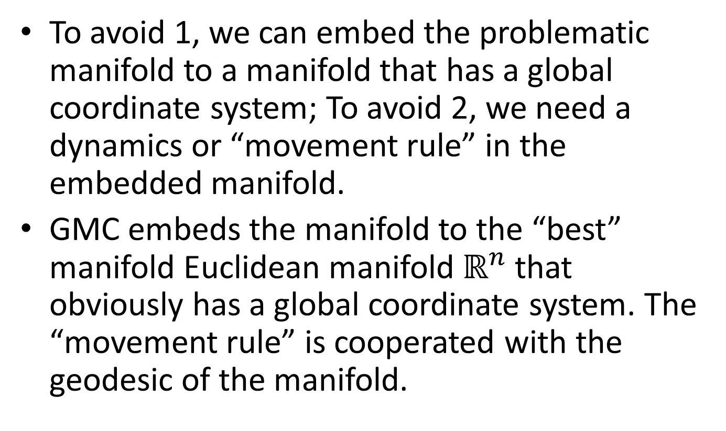
Overview
To avoid 1, we can embed the problematic manifold to a manifold that has a global coordinate system; To avoid 2, we need a dynamics or “movement rule” in the embedded manifold.
GMC embeds the manifold to the “best” manifold Euclidean manifold $ℝ^{n}$ that obviously has a global coordinate system. The “movement rule” is cooperated with the geodesic of the manifold.

Slide 45
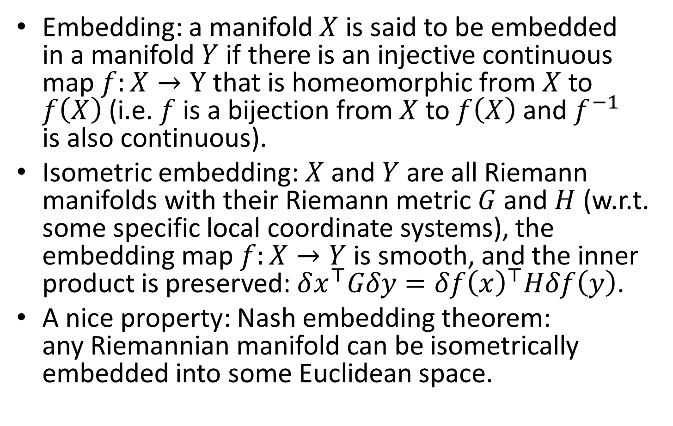
Embedding
Embedding: a manifold $X$ is said to be embedded in a manifold $Y$ if there is an injective continuous map $f:X→Y$ that is homeomorphic from $X$ to $f\left(X\right)$ (i.e. $f$ is a bijection from $X$ to $f\left(X\right)$ and $f^{−1}$ is also continuous).
Isometric embedding: $X$ and $Y$ are all Riemann manifolds with their Riemann metric $G$ and $H$ (w.r.t. some specific local coordinate systems), the embedding map $f:X→Y$ is smooth, and the inner product is preserved: $δx^{⊤}Gδy=δf{\left(x\right)}^{⊤}Hδf\left(y\right)$.
A nice property: Nash embedding theorem: any Riemannian manifold can be isometrically embedded into some Euclidean space.

Slide 46
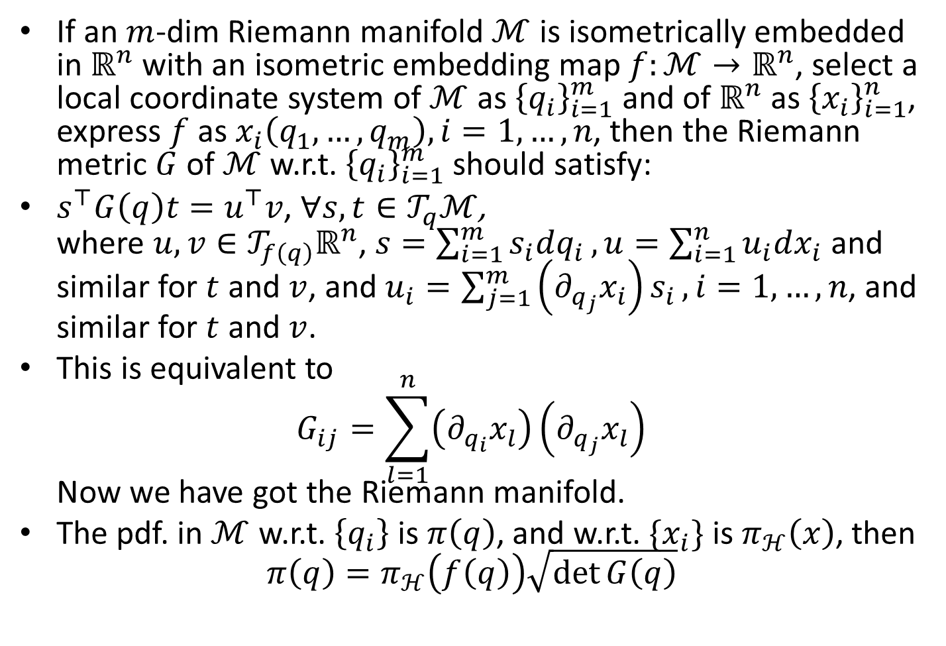
Embedding
If an $m$-dim Riemann manifold $ℳ$ is isometrically embedded in $ℝ^{n}$ with an isometric embedding map $f:ℳ→ℝ^{n}$, select a local coordinate system of $ℳ$ as ${\left\{q_{i}\right\}}_{i=1}^{m}$ and of $ℝ^{n}$ as ${\left\{x_{i}\right\}}_{i=1}^{n}$, express $f$ as $x_{i}\left(q_{1},…,q_{m}\right),i=1,…,n$, then the Riemann metric $G$ of $ℳ$ w.r.t. ${\left\{q_{i}\right\}}_{i=1}^{m}$ should satisfy:
$s^{⊤}G\left(q\right)t=u^{⊤}v$, $∀s,t∈𝒯_{q}ℳ$, where $u,v∈𝒯_{f\left(q\right)}ℝ^{n}$, $s=\sum_{i=1}^{m}{s_{i}dq_{i}}, u=\sum_{i=1}^{n}{u_{i}dx_{i}}$ and similar for $t$ and $v$, and $u_{i}=\sum_{j=1}^{m}{\left(∂_{q_{j}}x_{i}\right)s_{i}},i=1,…,n$, and similar for $t$ and $v$.
This is equivalent to $G_{ij}=\sum_{l=1}^{n}{\left(∂_{q_{i}}x_{l}\right)}\left(∂_{q_{j}}x_{l}\right)$ Now we have got the Riemann manifold.
The pdf. in $ℳ$ w.r.t. $\left\{q_{i}\right\}$ is $π\left(q\right)$, and w.r.t. $\{x_{i}\}$ is $π_{ℋ}\left(x\right)$, then $π\left(q\right)=π_{ℋ}\left(f\left(q\right)\right)\sqrt{\det{G\left(q\right)}}$

Slide 47
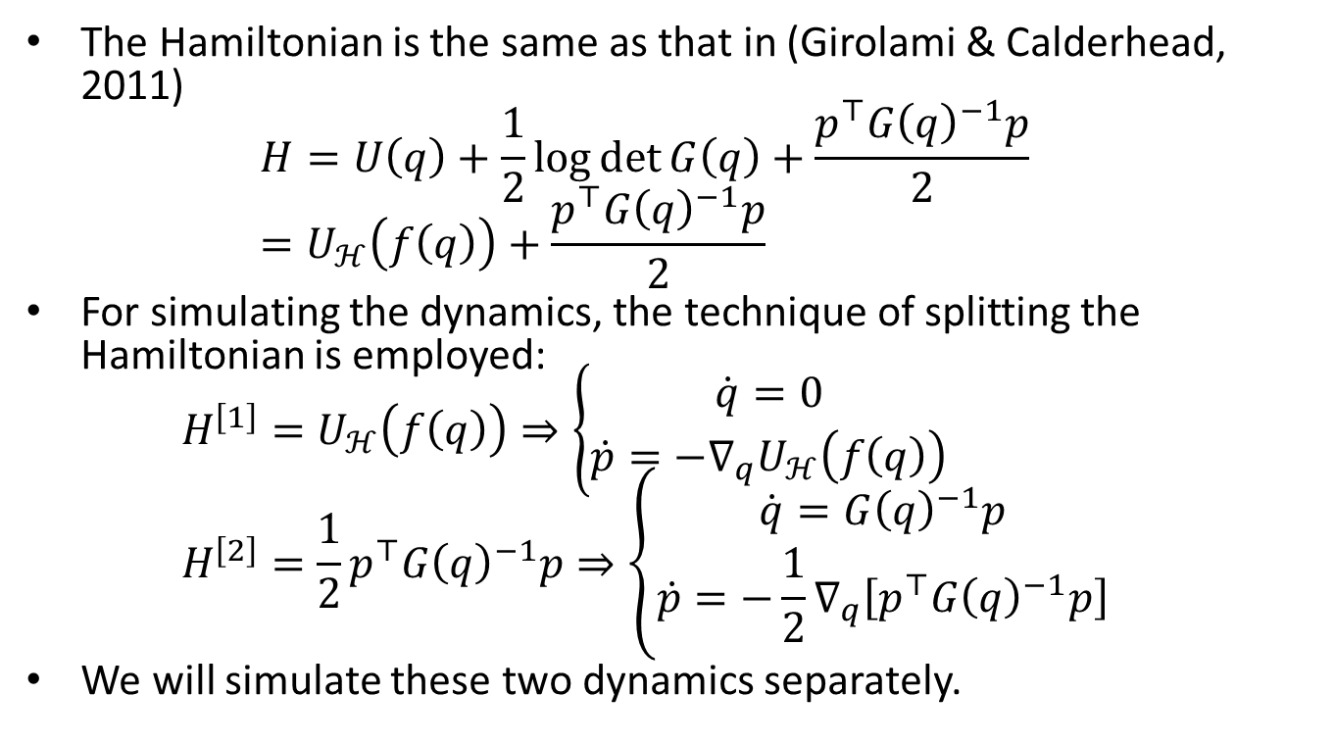
Derivation of Geodesic Monte Carlo
The Hamiltonian is the same as that in (Girolami & Calderhead, 2011) $H=U\left(q\right)+\frac{1}{2}\log{\det{G\left(q\right)}}+\frac{p^{⊤}G{\left(q\right)}^{−1}p}{2}$ $=U_{ℋ}\left(f\left(q\right)\right)+\frac{p^{⊤}G{\left(q\right)}^{−1}p}{2}$
For simulating the dynamics, the technique of splitting the Hamiltonian is employed: $H^{\left[1\right]}=U_{ℋ}\left(f\left(q\right)\right)⇒\left\{\begin{aligned}\dot{q}=0 \\ \dot{p}=−∇_{q}U_{ℋ}\left(f\left(q\right)\right)\end{aligned}\right.$ $H^{\left[2\right]}=\frac{1}{2}p^{⊤}G{\left(q\right)}^{−1}p⇒\left\{\begin{aligned}\dot{q}=G{\left(q\right)}^{−1}p \\ \dot{p}=−\frac{1}{2}∇_{q}\left[p^{⊤}G{\left(q\right)}^{−1}p\right]\end{aligned}\right.$
We will simulate these two dynamics separately.

Slide 48
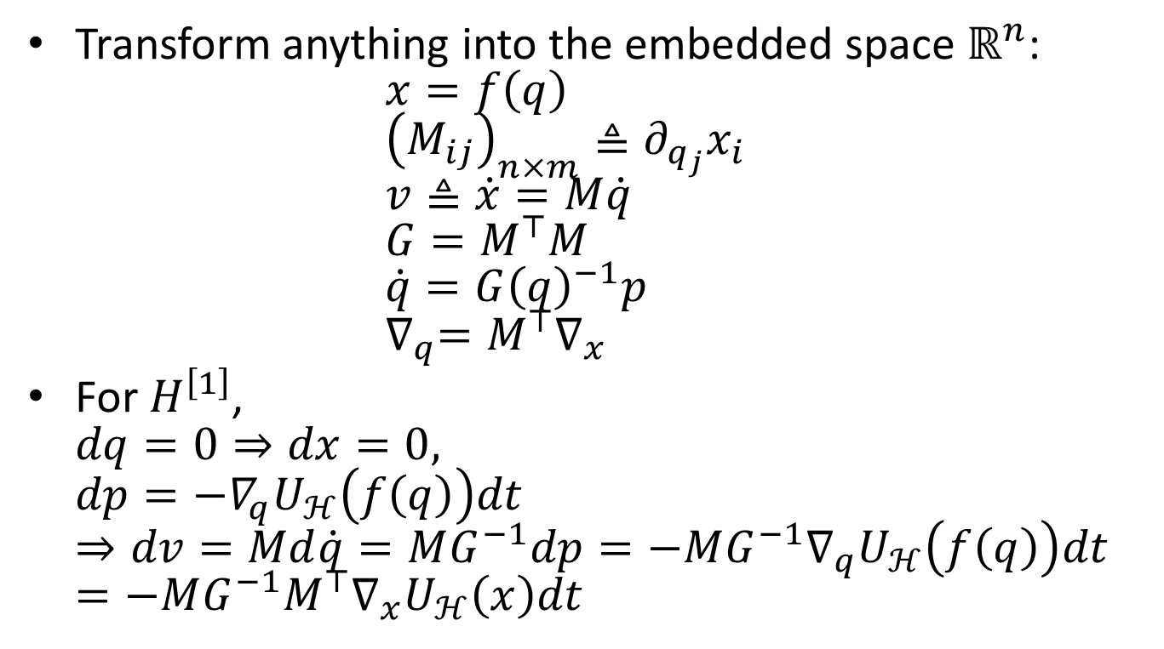
Derivation of Geodesic Monte Carlo
Transform anything into the embedded space $ℝ^{n}$: $x=f\left(q\right)$ ${\left(M_{ij}\right)}_{n×m}≜∂_{q_{j}}x_{i}$ $v≜\dot{x}=M\dot{q}$ $G=M^{⊤}M$ $\dot{q}=G{\left(q\right)}^{−1}p$ $∇_{q}=M^{⊤}∇_{x}$
For $H^{\left[1\right]}$, $dq=0⇒dx=0,$ $dp=−∇_{q}U_{ℋ}\left(f\left(q\right)\right)dt$ $⇒dv=Md\dot{q}=MG^{−1}dp=−MG^{−1}∇_{q}U_{ℋ}\left(f\left(q\right)\right)dt=−MG^{−1}M^{⊤}∇_{x}U_{ℋ}\left(x\right)dt$

Slide 49
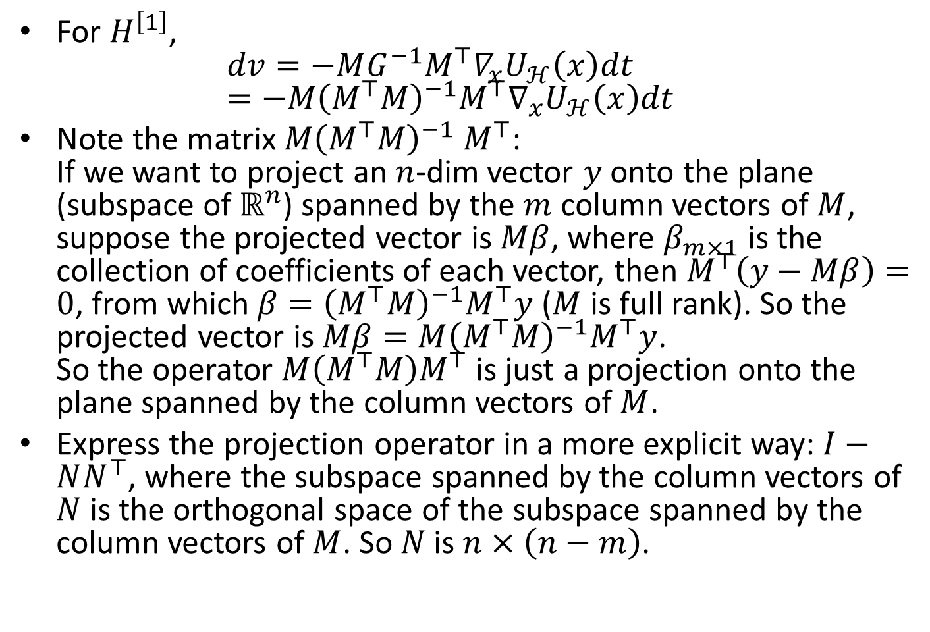
Derivation of Geodesic Monte Carlo
For $H^{\left[1\right]}$, $dv=−MG^{−1}M^{⊤}∇_{x}U_{ℋ}\left(x\right)dt$ $=−M{\left(M^{⊤}M\right)}^{−1}M^{⊤}∇_{x}U_{ℋ}\left(x\right)dt$
Note the matrix $M{\left(M^{⊤}M\right)}^{−1} M^{⊤}$: If we want to project an $n$-dim vector $y$ onto the plane (subspace of $ℝ^{n}$) spanned by the $m$ column vectors of $M$, suppose the projected vector is $Mβ$, where $β_{m×1}$ is the collection of coefficients of each vector, then $M^{⊤}\left(y−Mβ\right)=0$, from which $β={\left(M^{⊤}M\right)}^{−1}M^{⊤}y$ ($M$ is full rank). So the projected vector is $Mβ=M{\left(M^{⊤}M\right)}^{−1}M^{⊤}y$. So the operator $M\left(M^{⊤}M\right)M^{⊤}$ is just a projection onto the plane spanned by the column vectors of $M$.
Express the projection operator in a more explicit way: $I−NN^{⊤}$, where the subspace spanned by the column vectors of $N$ is the orthogonal space of the subspace spanned by the column vectors of $M$. So $N$ is $n×\left(n−m\right)$.

Slide 50
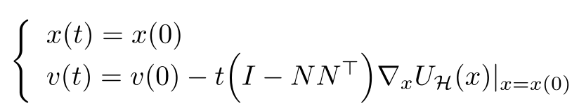

Derivation of Geodesic Monte Carlo
The final update rule for $H^{\left[1\right]}$ is $dx=0, dv=−\left(I−NN^{⊤}\right)∇_{x}U_{ℋ}\left(x\right)dt$ Note that $x$ does not change over $t$, this can be integrated as

Slide 51
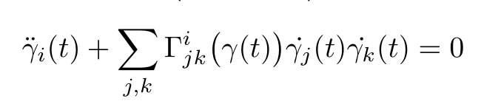
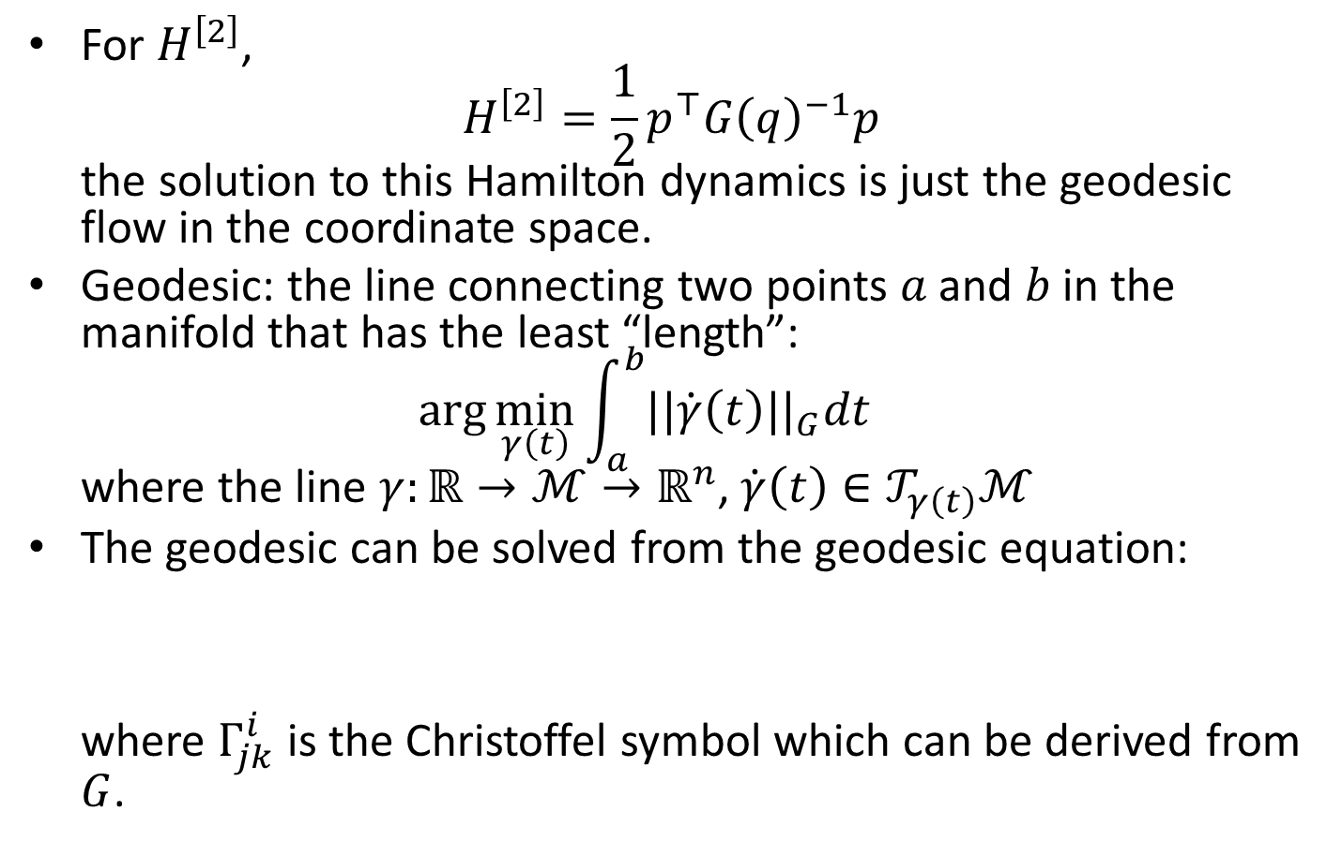
Derivation of Geodesic Monte Carlo
For $H^{\left[2\right]}$, $H^{\left[2\right]}=\frac{1}{2}p^{⊤}G{\left(q\right)}^{−1}p$ the solution to this Hamilton dynamics is just the geodesic flow in the coordinate space.
Geodesic: the line connecting two points $a$ and $b$ in the manifold that has the least “length”: $\arg{\min_{γ\left(t\right)}{\int_{a}^{b}{||\dot{γ}\left(t\right)||_{G}dt}}}$ where the line $γ:ℝ→ℳ→ℝ^{n}$, $\dot{γ}\left(t\right)∈𝒯_{γ\left(t\right)}ℳ$
The geodesic can be solved from the geodesic equation: where $Γ_{jk}^{i}$ is the Christoffel symbol which can be derived from $G$.

Slide 52

Derivation of Geodesic Monte Carlo
An example of geodesic

Slide 53

Derivation of Geodesic Monte Carlo
The geodesic flow is the movement on the manifold along the geodesic from the initial position and velocity. For a hypersphere,

Slide 54


Derivation of Geodesic Monte Carlo
Other operations: sample $v$. So for sampling $v$, we can just sample a r.v. from standard Gaussian and then project it onto the tangent space $𝒯_{q}ℳ$.

Slide 55

Derivation of Geodesic Monte Carlo
From the discussions above, we can write the GMC algorithm:

Slide 56
Discussions
Advantages:
A global coordinate system is not required, and the resultant method is irrelevant to any specific local coordinate systems as long as the distribution density in the embedded space is given
Straightforward to make proposals by Hamiltonian dynamics (iteration avoided), as long as the numerical geodesic update can be easily evaluated
Disadvantages:
Calls for the explicit form of the geodesic, and its numerical update should be easy
Notes:
Illustration of how to use RMHMC to do the same thing. Derive the metric of the sphere with local coordinate system as the equator plane.

Slide 57
References
Metropolis, N., Rosenbluth, A. W., Rosenbluth, M. N., Teller, A. H., and Teller, E. (1953). Equation of state calculations by fast computing machines. Journal of Chemical Physics, 21:1087–1092.
Alder, B. J. & Wainwright, T. E. (1959). Studies in molecular dynamics. I. General method. Journal of Chemical Physics, 31:459–466.
Duane, S., Kennedy, A. D., Pendleton, B. J., and Roweth, D. (1987). Hybrid Monte Carlo. Physics Letters B, 195:216–222.
Neal, R. M. (1996a). Bayesian Learning for Neural Networks. Lecture Notes in Statistics, No. 118. Springer-Verlag.
Rao, C. R. (1945). Information and accuracy attainable in the estimation of statistical parameters. Bull. Calc. Math. Soc., 37, 81–91.

Slide 58
Thanks!

